Slide 1
Eosinofiele Oesofagitis
Arjan Bredenoord
MDL-Arts
Amsterdam UMC
NVGE Cursorisch Onderwijs | Oktober 2019

Slide 2
Disclosures
Research funding from Nutricia, Norgine and Bayer and received speaker and/or consulting fees from Laborie, EsoCap, Diversatek, Medtronic, DrFalk, Calypso, Thelial, Regeneron, Celgene, Bayer, Norgine, AstraZeneca, Almirall and Allergan

Slide 3
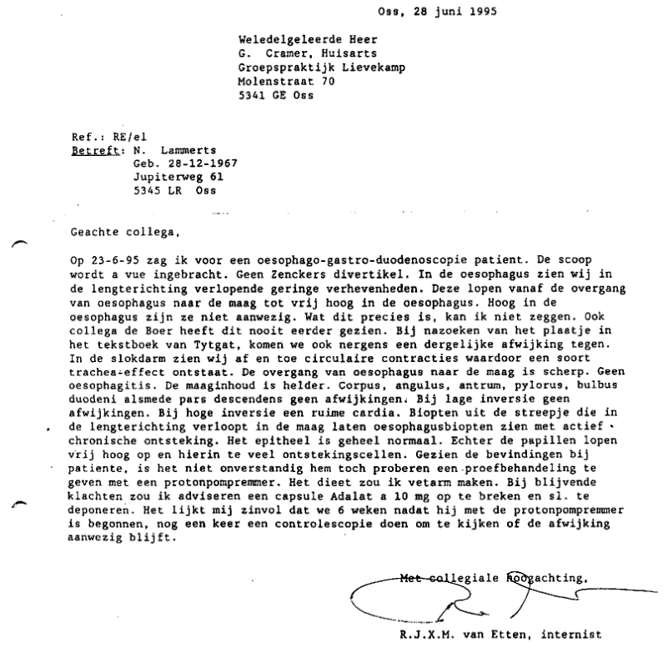

Slide 4
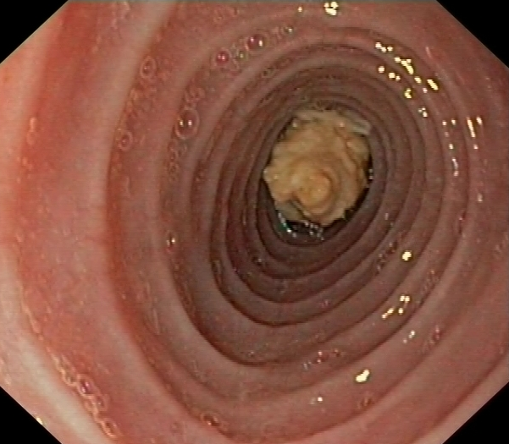
2010: ♂ 42 yrs old
Acute obstruction after swallowing piece of chicken
Saliva does not pass
Pain behind the sternum

Slide 5
2010: ♂ 42 yrs old
History:
1997: regular food impactions, dysphagia for solids, no problems with drinking
Gastroscopy: concentric rings with mid-oesophageal stricture
Conclusion: “congenital ringed esophagus”, treated with bougie dilatations
1997-2008: Multiple bougie dilatations in AMC en other hospitals and endoscopic treatments for food impactions

Slide 6
2010: ♂ 42 yrs old
History:
1997: regular food impactions, dysphagia for solids, no problems with drinking
Gastroscopy: concentric rings with mid-oesophageal stricture
Conclusion: “congenital ringed esophagus”, treated with bougie dilatations
1997-2008: Multiple bougie dilatations in AMC en other hospitals and endoscopic treatments for food impactions
Histology: impressive eosinophilia, no candida
Conclusion: eosinophilic esophagitis, start topical fluticasone
After 3 months: less dysphagia, no more food impactions

Slide 7
Pathogenesis
Genetic component
  Family history
  Genetic associations, oa filagrin gene
High prevalence of atopy
Role of food allergens
  Remission during elementary diet
Rothenberg et al. Nat Genetics 2010
Moawad et al. APT 2010

Slide 8
Clinical presentation
Adults
Dysphagia (93%)
Food impaction (62%)
Chest pain
Heartburn
Atopy:
  Rhinoconjunctivitis 57%
  Asthma 37%
  Food allergy 46%
  Atopic dermatitis
Children: more atypical presentation
Feeding difficulty
Abdominal pain
Nausea, vomiting
Heartburn
Failure to thrive
United European Gastroenterology Journal 2017

Slide 9
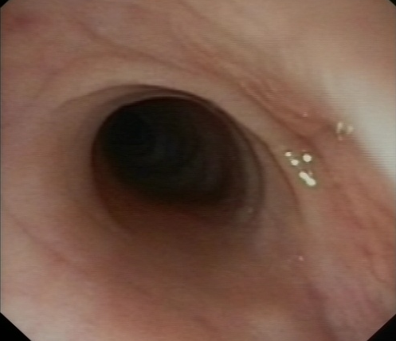
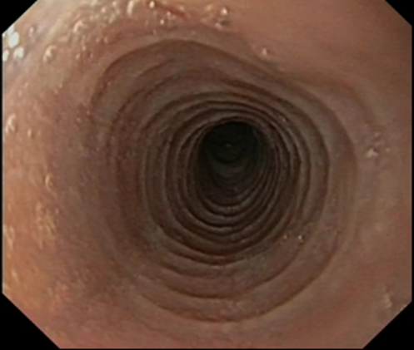
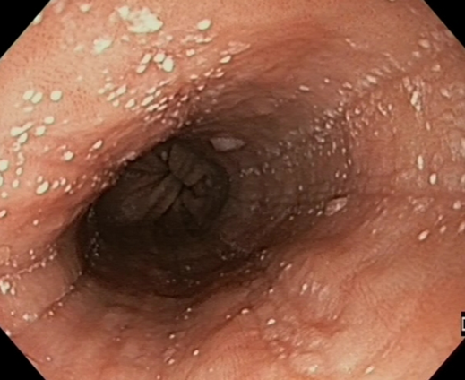
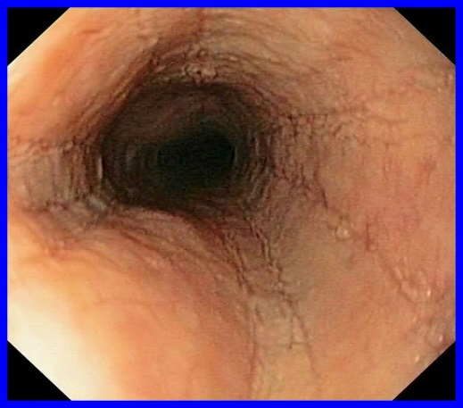
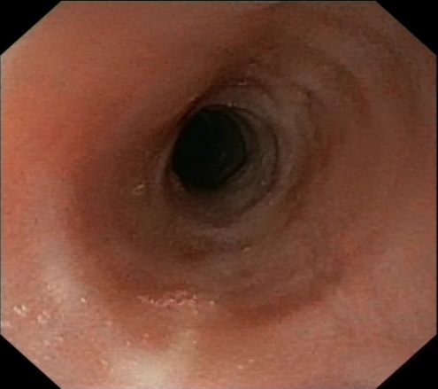
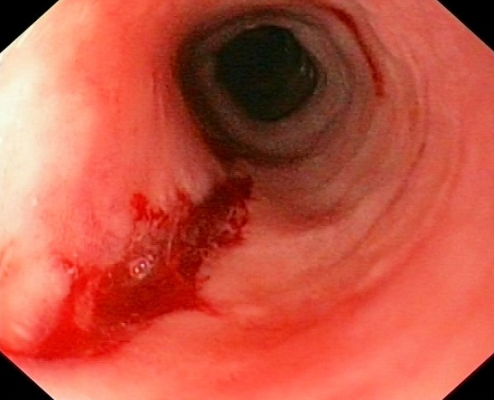
Endoscopic Signs of EoE: EREFS
E
R
E
F
S

Slide 10
Endoscopic Signs of EoE: EREFS
Edema
Rings
Exsudates
Furrows
Stricture
(Crepe paper esophagus)

Slide 11
Endoscopic Signs of EoE: EREFS
Edema
Rings
Exsudates
Endoscopic signs present in 93% of cases - Absent in 7%
Furrows
Stricture
(Crepe paper esophagus)

Slide 12
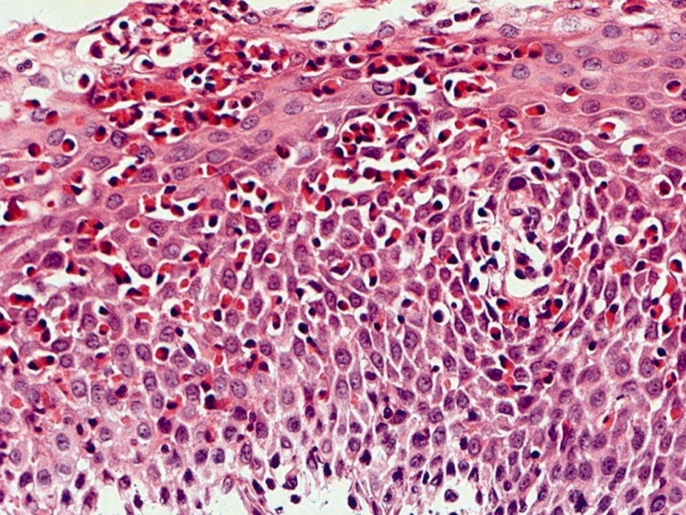
Eosinophilic esophagitis (EoE)
Normally hardly any eosinophils in the esophagus
AGREE Consensus Dellon et al. Gastroenterology 2018

Slide 13
Epidemiology

Slide 14
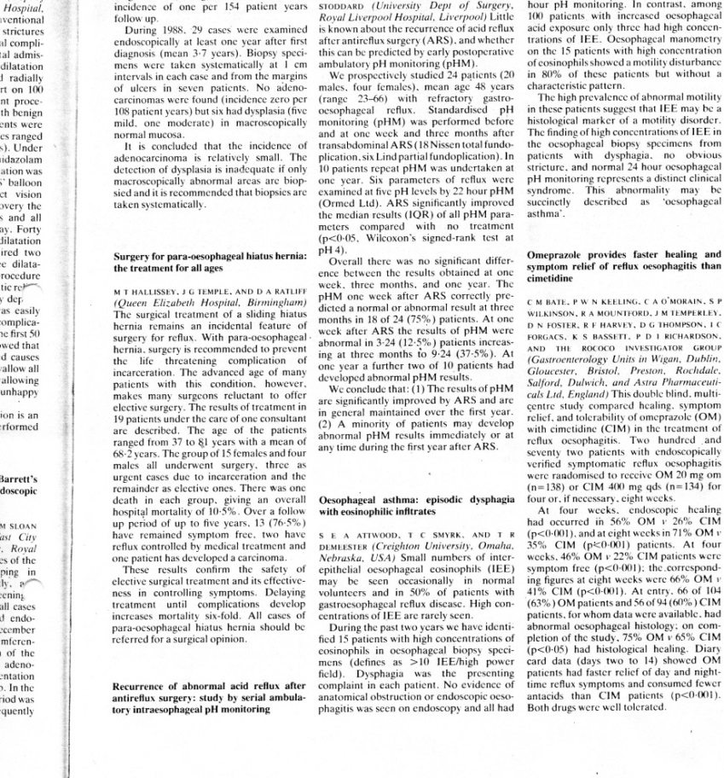
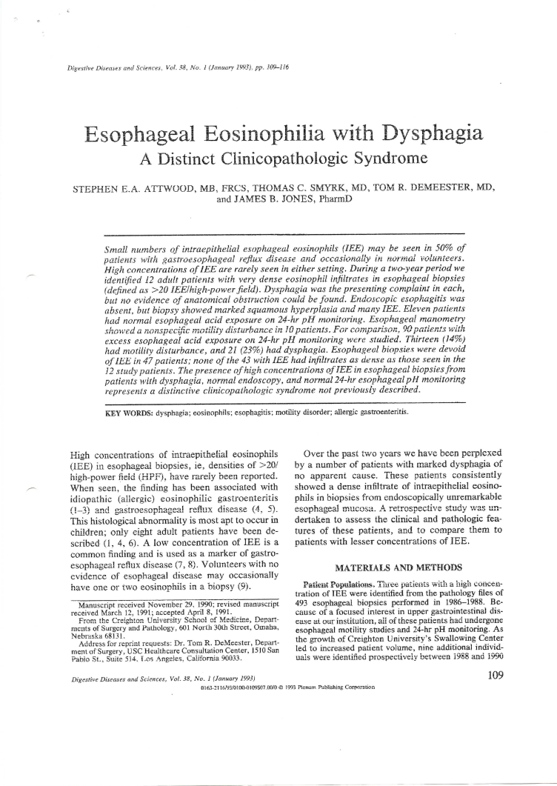
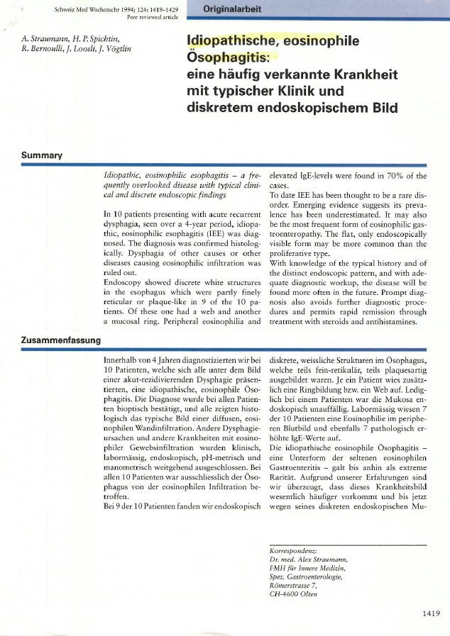
Epidemiology EoE
1994
10 patients with “eosinophile ösophagitis”
1993
full paper
Abstract BSG 1989
“Oesophageal asthma”
15 patients with episodic dysphagia with eosinophilic infiltrates on oesophageal biopsy

Slide 15
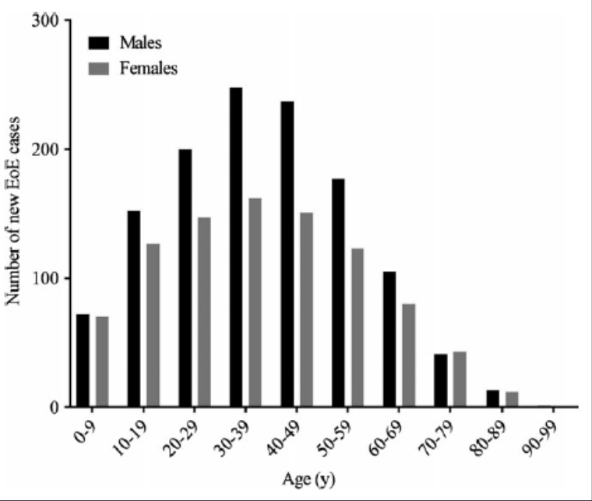
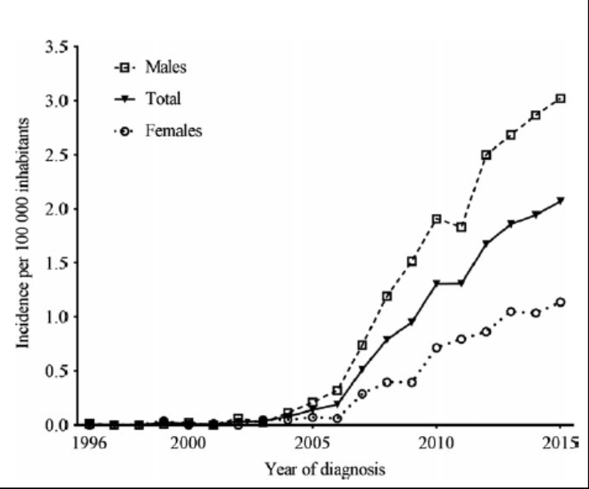
Epidemiology EoE: PALGA Database
Warners et al Neurogastroenterol Motil 2017

Slide 16
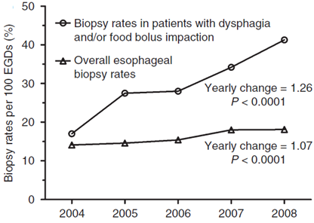
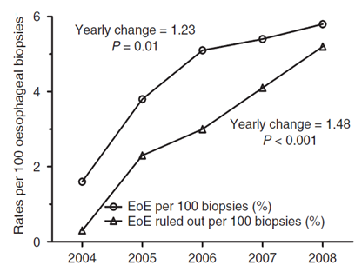
Biopsy rates during endoscopy
Mentioning of EoE in pathology report
Increased awareness of both endoscopist and pathologist
Syed et al. APT 2012

Slide 17
Why treat EoE?
-> why treat any chronic diseases that can not be cured?
Reduce bothersome symptoms
Prevent long term complications
Treatment objectives:
Reduce symptoms
Induce histological remission

Slide 18
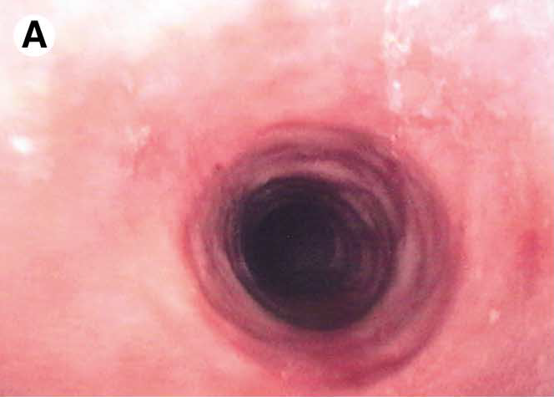
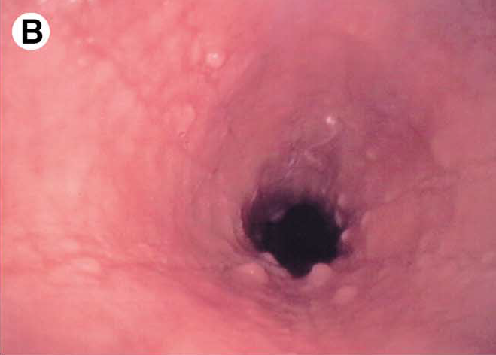
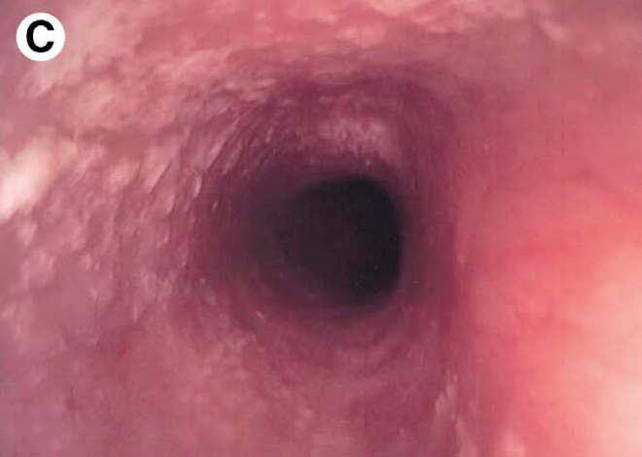
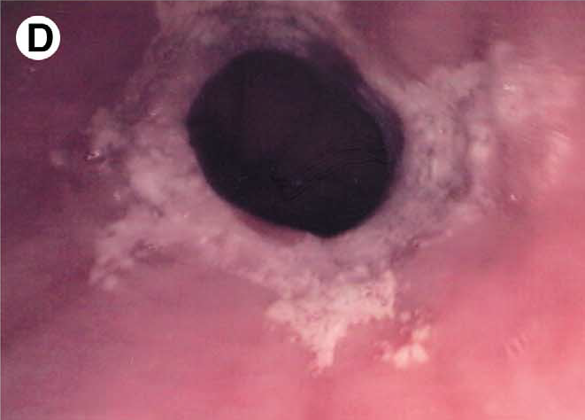
Natural history of EoE:
a follow-up of 11.5 yrs
20-yr-old pt with 5-yr history; almost no abnormalities
56-yr-old pt with 3-yr history; nodules and red furrows classified as minimal
24-yr-old pt with 10-yr history;
plaques classified as moderate
39-yr-old pt with 22-year history; stenosis classified as severe

Slide 19
Natural history of EoE:
a follow-up of 11.5 yrs
Long term follow up of 30 untreated EoE patients
Dysphagia persisted in 29 patients
Esophageal eosinophilic infiltration persisted, but spontaneously decreased (79 vs 40/HPF)
Increase in fibrosis of lamina propria
No spread to stomach or duodenum
No malignancy developed
EoE is a chronic disease restricted to the esophagus,
leads to persistent dysphagia and esophageal fibrosis

Slide 20
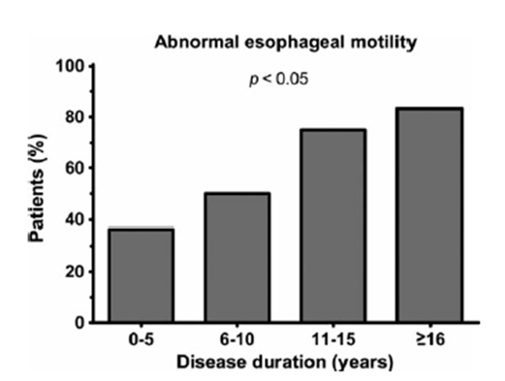
Esophageal motility abnormalities in untreated EoE
van Rhijn et al. Neurogastroenterol Motil 2014

Slide 21
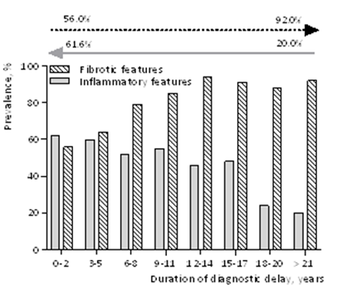
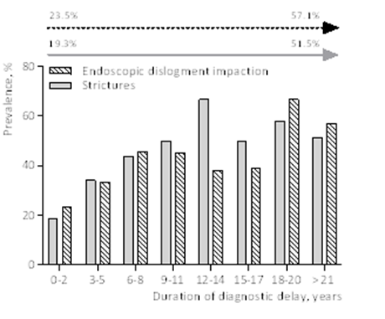
The Natural Course of Eosinophilic Esophagitis (EoE) and Long-term Consequences of untreated disease
Review of 721 patient files in 15 Dutch hospitals
Strictures
Endoscopic food dislodgement
Fibrotic signs
Inflammatory signs
Prolonged untreated disease leads to esophageal strictures and an increased risk of food impaction
Warners et al. Am J Gastroenterol 2018

Slide 22
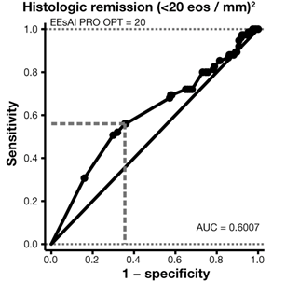
Can symptoms predict histological treatment response in EoE?
Symptoms measured with validated EoE Activity Index (EEsAI)
Symptoms not sufficient to predict histologic activity
Schoepfer et al. Gastroenterology 2016

Slide 23
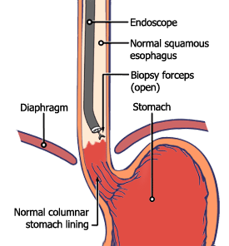
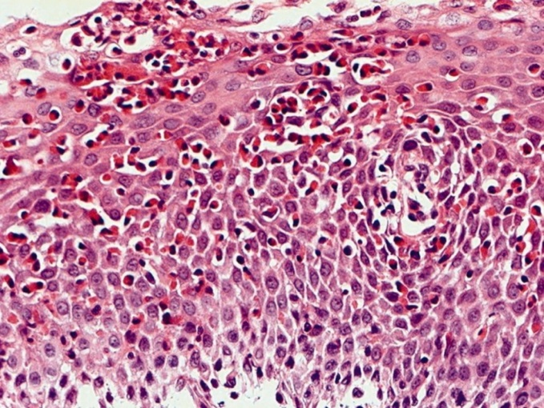
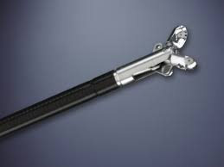
Esophageal mucosal biopsies required to assess treatment effect
Counting Peak Eosinophil number / HPF
6 biopsies

Slide 24
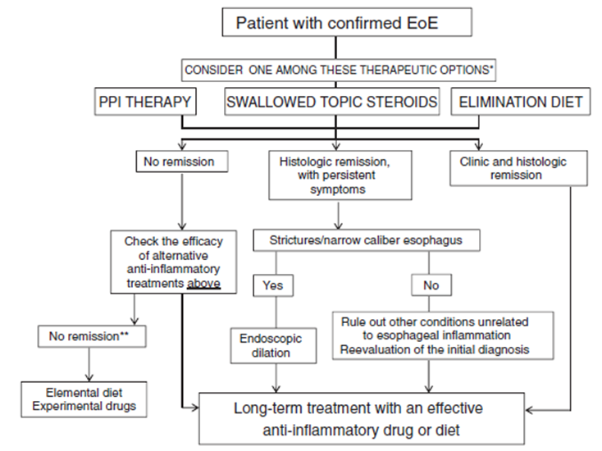
Management of EoE
Lucendo et al. UEG Journal 2017

Slide 25
Effect of acid suppression: PPI
3 patients with dysphagia, endoscopic signs of EoE and >20 Eos/ HPF
Trial of PPI
Results: Strong improvement of symptoms, endoscopy and histology
PPI-responsive eosinophilia (PPI-REE)
Conclusion of authors: this is not EoE, but GERD
Alternative conclusion: also EoE responds to PPI
Ngo et al. Am J Gastroenterol 2006

Slide 26
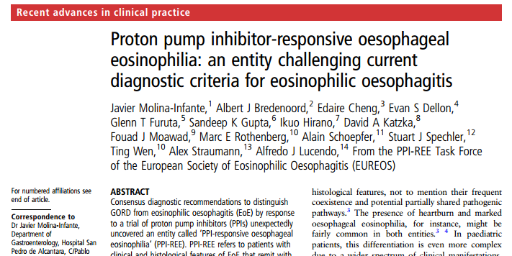
PPI-responsive esophageal eosinophilia
Patients with EoE phenotype, but response to PPI
  GERD, EoE, both or separate entity?
Acid reflux can potentiate esophageal allergen uptake
PPI-REE similar to EoE in endoscopy, moleculair pattern, symptoms and histology, both different from GERD
“…consider PPI therapy not as a diagnostic test, but as a therapeutic agent.
PPI can be considered a first-line treatment ….”

Slide 27
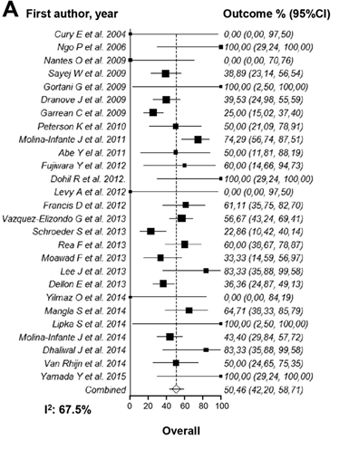
Effect of PPIs in EoE
619 EoE patients
Clinical response in 60.8%
Histological remission in 50.5%
More effective twice daily vs once daily 55.9% vs 49.7%
Lucendo et al. Clin Gastroenterol Hepatol 2016

Slide 28
Topical steroids
Off label pharmacy-made or pulmonary formulations
  Spray in mouth and swallow – not inhale
    Fluticason spray 250ug BID
    Budesonide spray 0.5-1.0 mg BID or enema 2.3 mg
  Ask patient not to eat / drink for 30 min afterwards
  Disadvantages:
    Off-label
    Not so favourable drug distribution

Slide 29
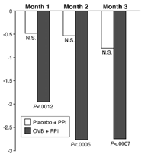
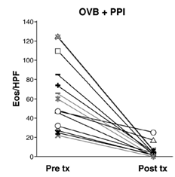
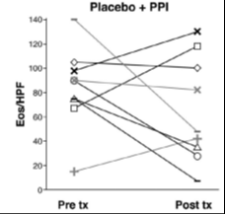
Oral viscous budesonide is effective in children with EoE
Children with EoE
RCT of PPI+oral viscous budesonide 1-2 mg vs PPI+placebo
OVB N=15 vs placebo N=9
Significant decrease in symptoms
86.7% response vs 0% histologic response
Dohil et al. Gastroenterology 2010

Slide 30
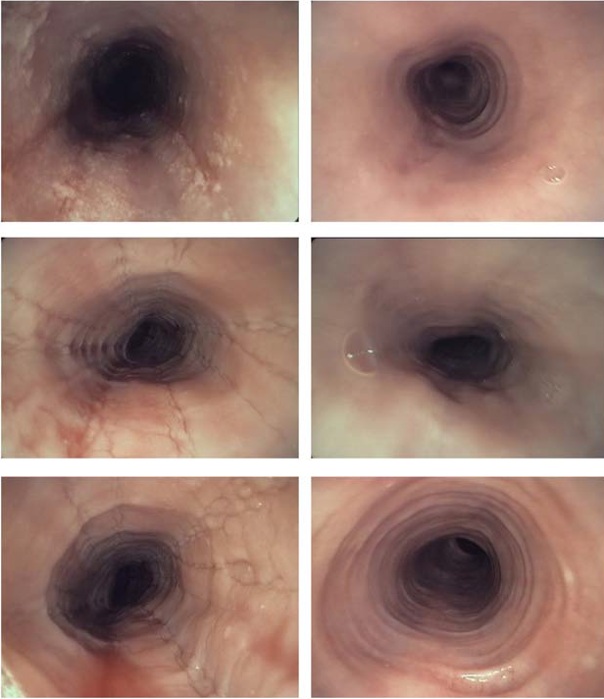
Effect of oral viscous budesonide in adults with EoE
RCT of 15 days budesonide 1 mg BID topically
N=36 adult EoE patients
Significant improvement in dysphagia with budesonide
Baseline
Budesonide
Effect on eosinophils
# Eos /HPF
Budesonide
Placebo
Straumann et al. Gastroenterology 2010

Slide 31
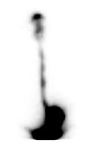
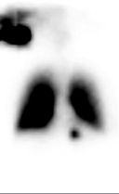
Viscous topical steriods are more effective than nebulized steroid therapy
RCT viscous budesonide vs nebulized and swallowed (1 mg BID)
Duration 8 weeks
N=22, age 35
Scintigraphically marked
Nebilized and swallowed budesonide
Viscous budesonide
Nebulized and swallowed budesonide rather ineffective distribution
Dellon et al. Gastroenterology 2012

Slide 32
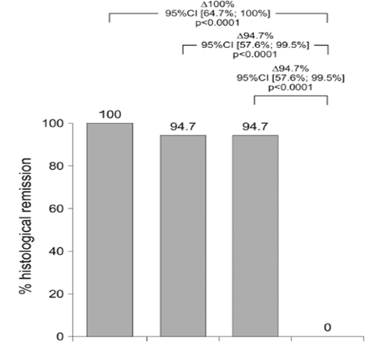
Different budesonide formulations and dosages for short term treatment
RCT, 76 EoE patients
Sign improvement in dysphagia (SDI)
Local fungi in 10.5%
80% prefer effervescent tablet above suspension
Eff tablet 2x1mg
Eff tablet 2x2mg
Suspens
2x2mg
Placebo
Miehlke et al. Gut 2015

Slide 33
Budesonide effervescent for EoE induction treatment
Histological response
after 6 weeks (n=88)
Clinical response
after 6 weeks EEsAI (n=88)
93 %
0 %
Budesonide
Efferv 1 mg BID
Placebo
Budesonide
Efferv 1 mg BID
Placebo
Local fungi infection in 5 % under budesonide, 0 % placebo
No change in morning cortisol levels
Budesonide orodispersible tablet is highly effective and safe for remission induction
Lucendo et al. Gastroenterology 2019

Slide 34
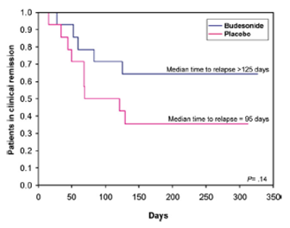
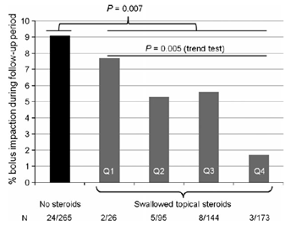
Topical steroids maintenance treatment
50 weeks 0.25 mg budesonide BID or placebo
28 pts with EoE in remission (adult and children>14 yrs)
Retrospective analysis of Swiss EoE Cohort
Few steroids
Daily steroids
Budesonide extended time in remission, but did not prevent recurrence
Topical corticosteroids reduce occurrence of bolus impactions
Straumann et al. Clin Gastrol Hepatol 2011
Kuchen et al. Allergy 2014

Slide 35
Dietary treatments
Elementary diets: amino-acid based formulas
Elimination diets: elimination of certain food allergens

Slide 36
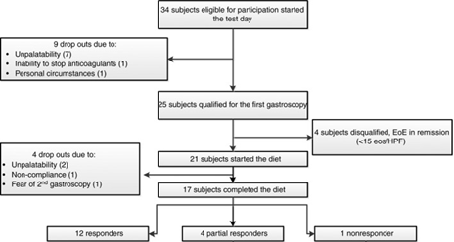
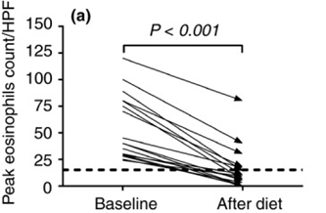
Elemental diet in adult EoE patients
4 week trial of Neocate (Nutricia), no other foods allowed besides tea and sugar free chewing gum
Straumann Dysphagia Instrument decreased from 6 (3–8) to 0 (0–0)
- 15/17 (88%) patients became completely asymptomatic
EREFS endoscopic scores decreased from 7 (4–8) to 3 (2–6)
- Only inflammatory EREFS signs decreased, fibrostenotic EREFS signs did not
Warners et al. APT 2017

Slide 37
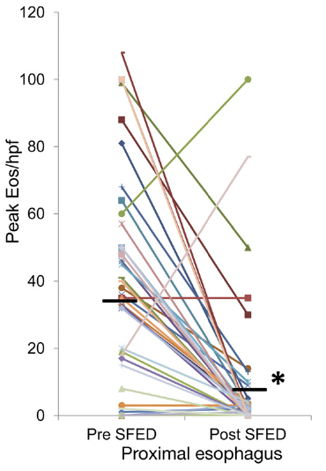
Six food elimination diet in adults with EoE
50 subjects with EoE
6 weeks removal of most common food allergens: cow’s milk, soy, wheat, egg, peanut, seafood
Results:
  74% histologic response (< 10 eos/hpf)
  90% symptom response
Gonsalves et al. Gastroenterology 2012

Slide 38
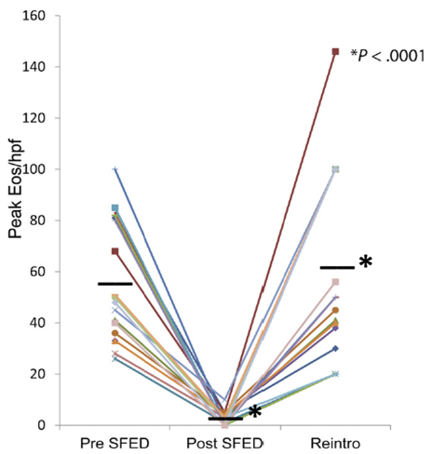
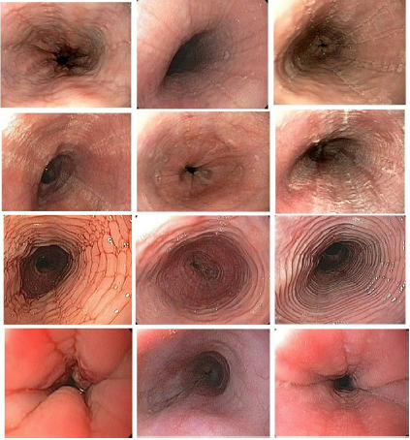
Effect of food reintroduction
Baseline
Post diet
Reintro
Skin prick testing was predictive in 13%
Gonsalves et al. Gastroenterology 2012

Slide 39
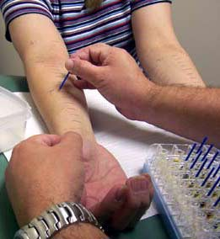
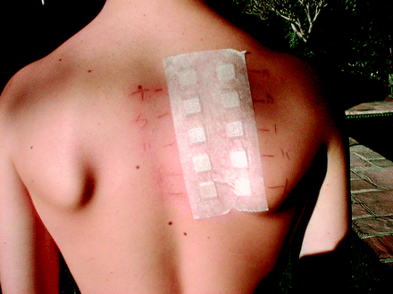
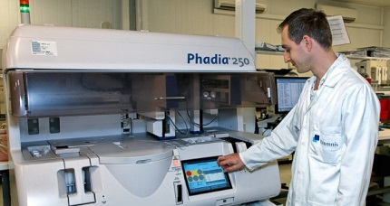
Elimination diets
Emperic exclusion of prevalent allergens (milk, soja, wheat, egg, peanut of shellfish)
  Adherence is problem: very broad exclusion
  Symptoms unreliable for exclusion
  Multiple endoscopies with biopsies, for each food group
Diets based on results of allergy testing
Skin prick tests
Serum IgE test
Atopy patch test

Slide 40
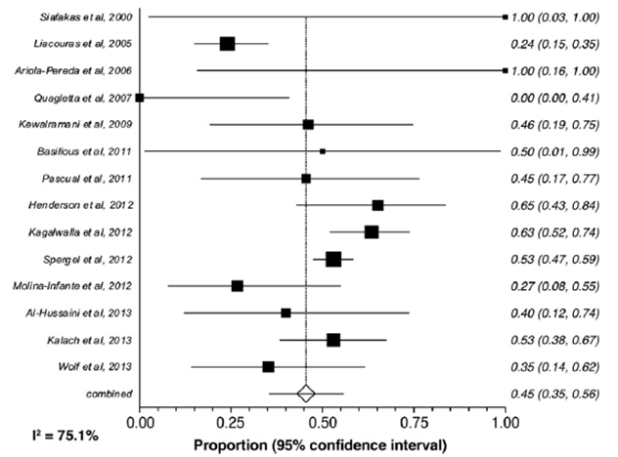
Diets based on allergy tests: meta-analysis
Efficacy of allergy test-based diets: 45%
Arias et al. Gastroenterology 2014

Slide 41
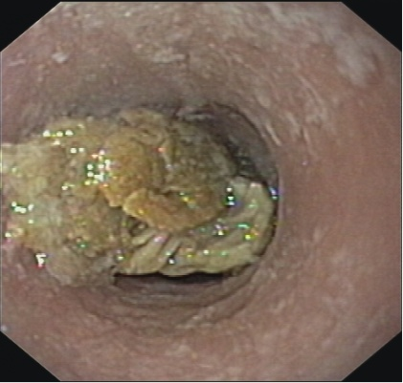
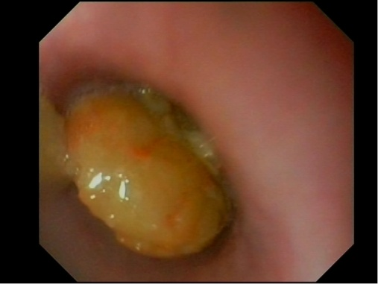





Food bolus impaction: which food?
Symptoms:
Acute dysphagia
Inability to swallow saliva
Pain retrosternal or in the neck (location not predictive for obstruction site)

Slide 42
Management of food bolus impaction
80% spontaneous passage
Potential complications:
  Ulcer, lacerations, perforations, fistula formation, aspiration
When endoscopy (ESGE):
  total obstruction, meat with bones -> emergency scopie
  partial obstruction, with saliva passage -> within 24 hr
  spontaneous passage -> electively
Endoscopic removal:
  Forceps, snare, net, basket
  Consider overtube when large volume of food and/or high risk for aspiration

Slide 43


Dilation
Bougie or balloon dilation
  Dilation does not influence underlying inflammation
Literature before 2008: 5% perforation
More recent series:
    0-0.8% perforation
    75% improvement in dysphagia
    80% symptom recurrence < 1 year
Advice:
    Dilation most effective in short strictures
    First perform trials of PPI and topical corticosteroids
Moawad et al. APT 2013

Slide 44




Slide 45


Safety and efficacy of dilation
Moawad et al. APT 2013

Slide 46
Conclusions: management of EoE
Prevent treatment delay, ongoing inflammation leads to strictures
Treatment aims: reduce symptoms, prevent long term complications
PPI
Topical corticosteroids
  Effective remission induction
  Moderately effective for maintenance therapy
  New dedicated formulations seem more effective
Diets
Check treatment effect with endoscopy+ biopsy, continu treatment

Slide 47

Meer informatie:

