Slide 1

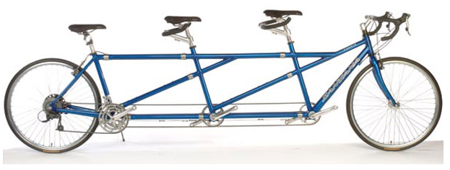
IBD and family planning
Marijn Visschedijk
19 maart 2024
MDL-arts

Slide 2
Leerdoelen
Ziektebeloop tijdens zwangerschap
Hoe behandel je een exacerbatie?
Welke geneesmiddelen wel en niet?

Slide 3

Join by Web
PollEv.com​/ibdandfamily
Join by Text
Send ibdandfamily and your message to +31 970 0449 8375
Skip for now, daarna Naam invoeren

Slide 4
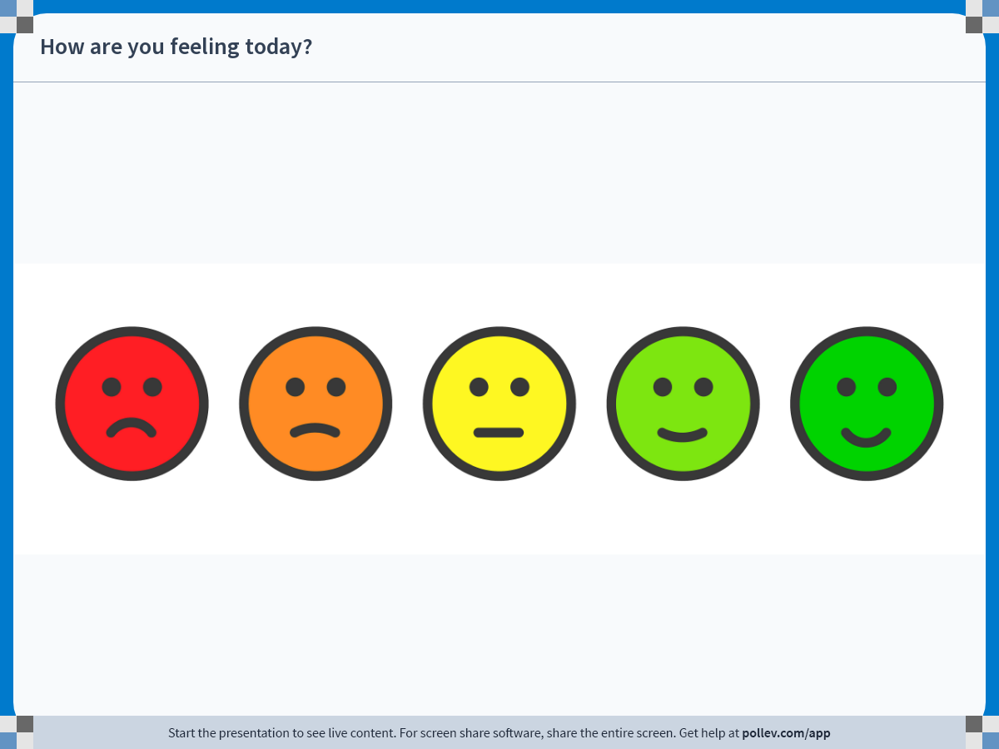
Notes:
Do not modify the notes in this section to avoid tampering with the Poll Everywhere activity.
More info at polleverywhere.com/support
How are you feeling today?
https://www.polleverywhere.com/clickable_images/1FgGtXYb5dcqIWrqFwPHl

Slide 5
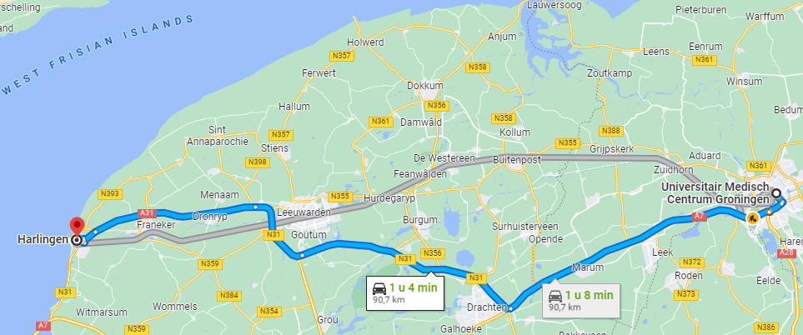
Case
27 years old lady, Polish origin, living in Harlingen (90km)

Slide 6
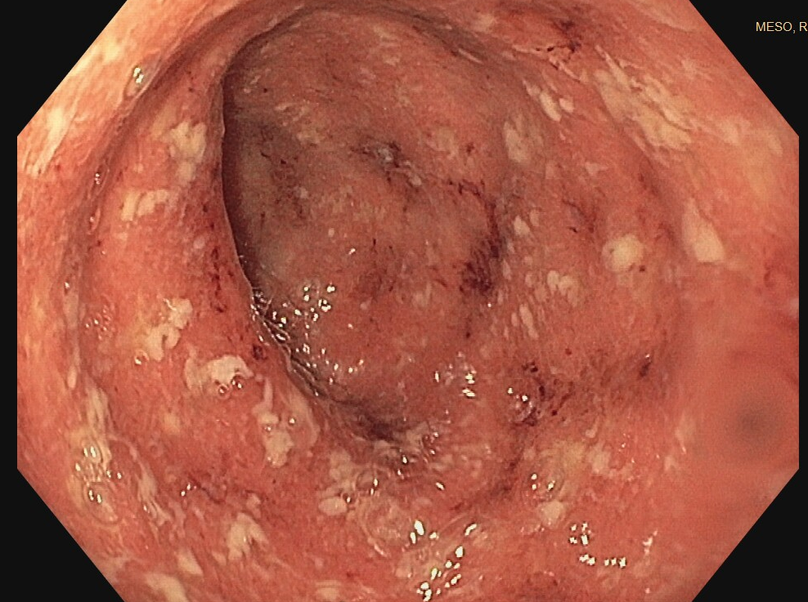
Case, first hospitalization
2-2022; consultation fertility-clinic because of primary subfertility
→ no abnormalities found. Advice: stop smoking
5-2022; hospitalized, 13 weeks pregnant; bloody diarrhoea and anaemia (Hb 3.6 mmol/L), CRP 30.
10-5-2022; pancolitis, endoscopic
ulcerative colitis Mayo 3.
Calprotectine 1095 mg/kg
Notes:
Klachten speelden 1 maand, april Hb 7.5

Slide 7
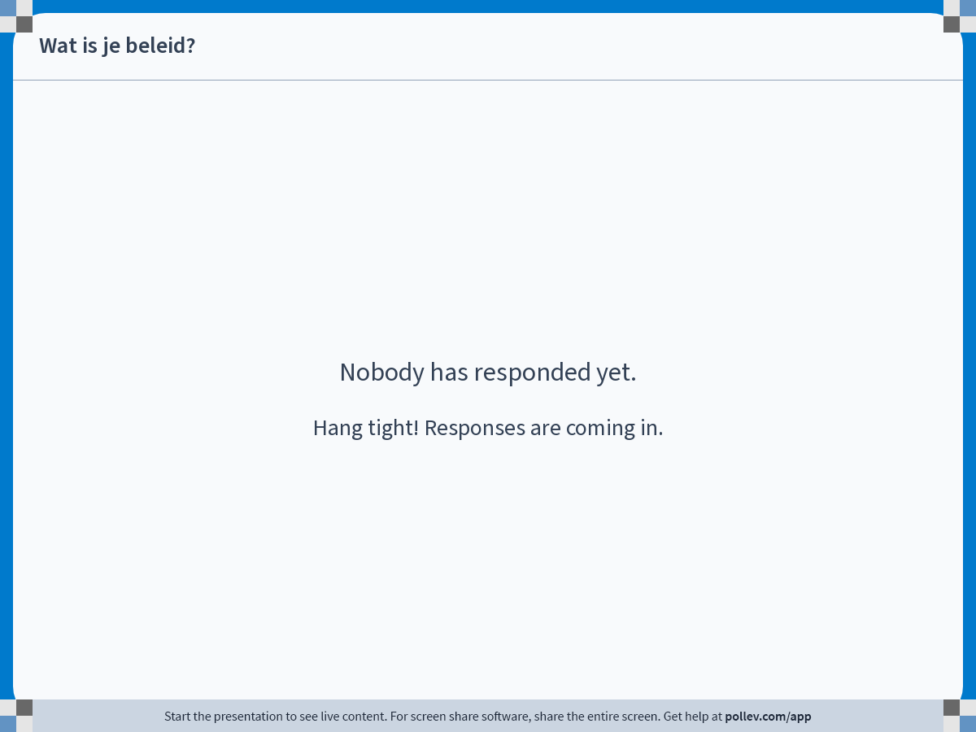
Notes:
Do not modify the notes in this section to avoid tampering with the Poll Everywhere activity.
More info at polleverywhere.com/support
Wat is je beleid?
https://www.polleverywhere.com/free_text_polls/diWjQqgtUIdEmnLGFV0YV

Slide 8
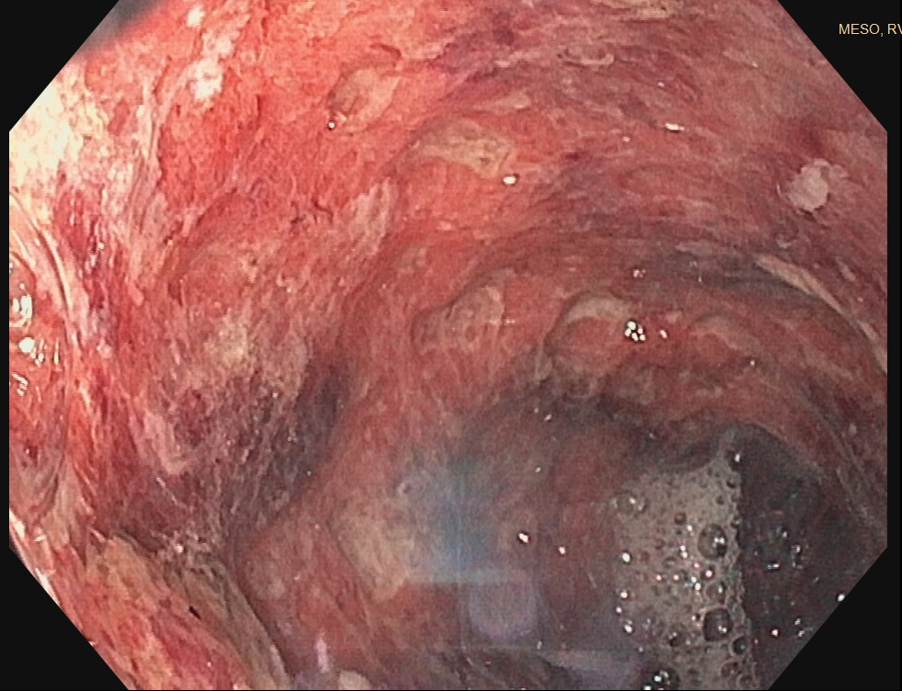
Case ~ treatment
Prednisolon 40 mg/kg, non-respons
Start Cefuroxim/metrodinazole.
Start Infliximab 10 mg/kg.
Repeated 1 week later.
Start mesalazine
19-6 re-hospitalisation, 18 weeks pregnancy, due to pancreatitis by mesalazine
20-6 sigmoidoscopy, MAYO 2 pancolitis
→ Transfer to University Medical Hospital Groningen
Sigmoidoscopy 14-5

Slide 9
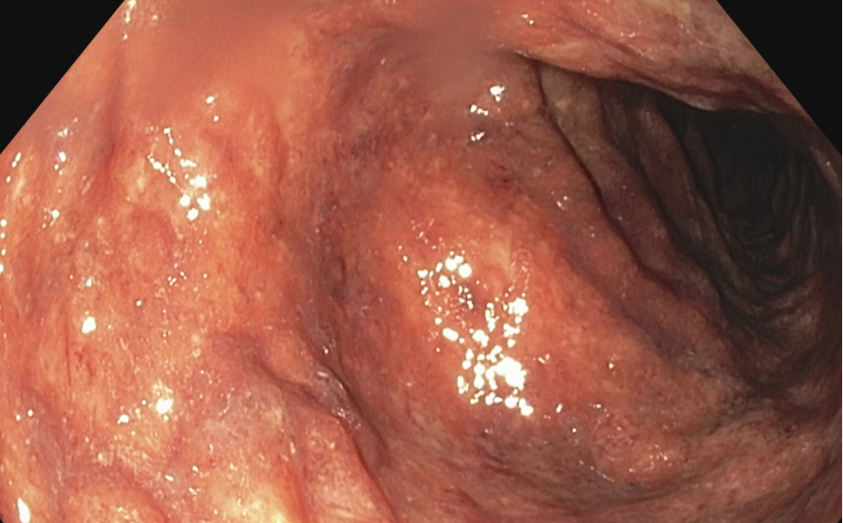
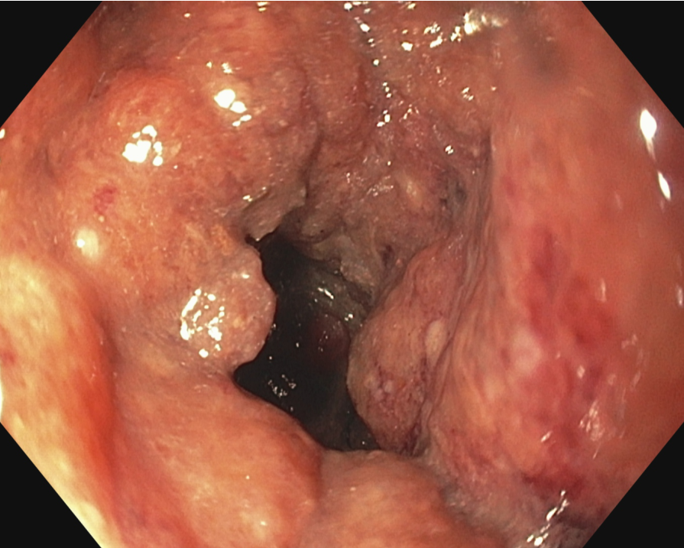
Case ~ second hospitalisation
21-6 – 14-7 hospitalisation UMCG; mesalazine stop, fluid intravenous, prednisolon 2 times 30 mg,
CRP 54 → 1.1, normalising stool frequency.
IFX-level 25 ug/ml, top-level, Infliximab continued.
Sigmoidoscopy 23-6-2022

Slide 10
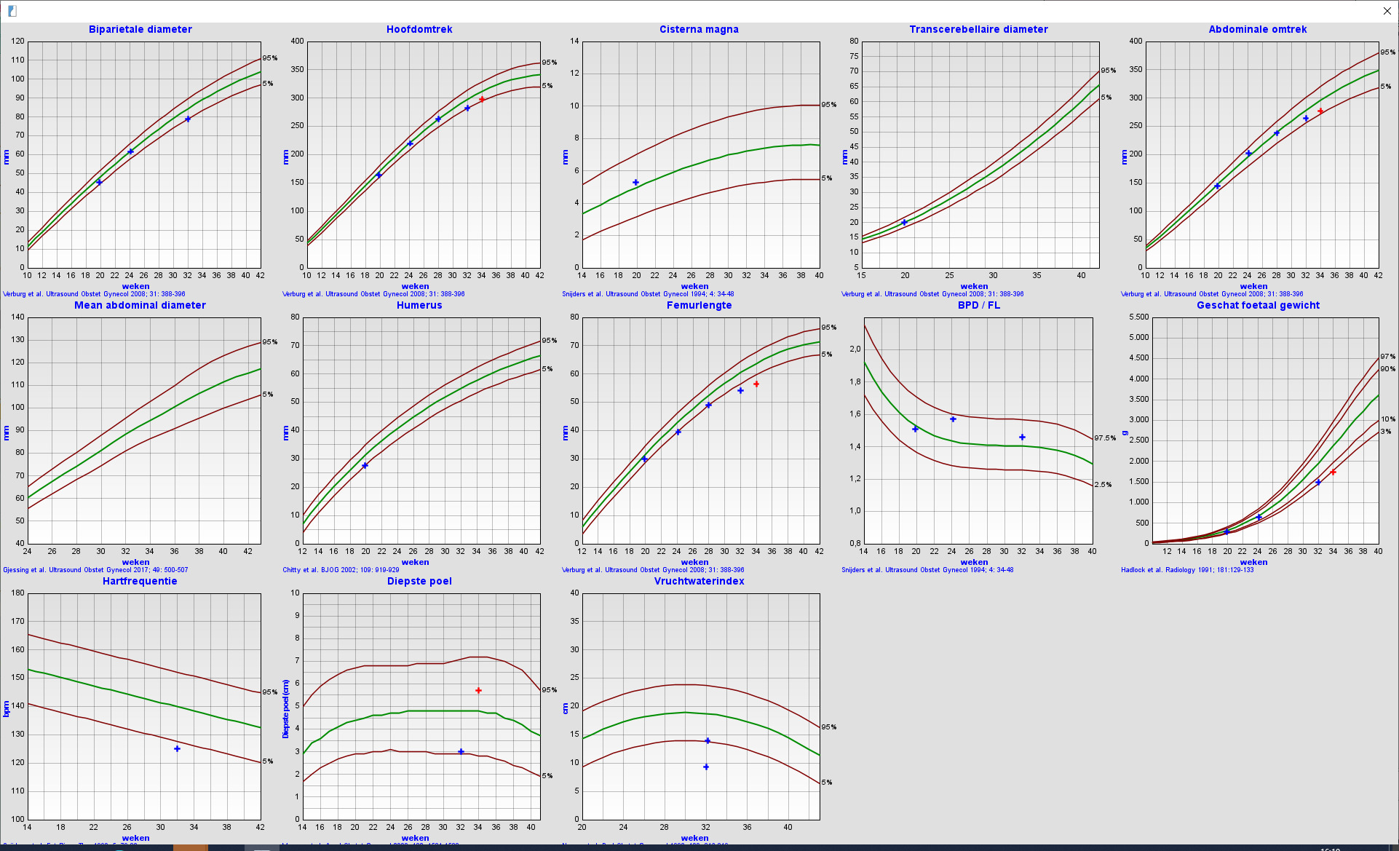
Outpatient clinic
AD 35w6D, hospitalisation abnormal CTG
Secundaire sectio caesarea; boy, birth weight 1840 g, normal apgar scores.

Slide 11
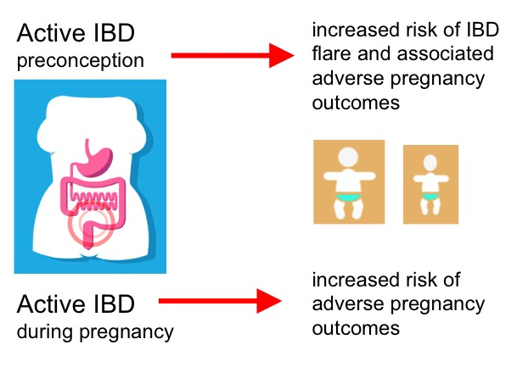
Notes:
Actieve ziekte: te licht, verhoogde kans op miskramen en vroeggeboorte. Fertiliteitsrate lager. Pouchs.

Slide 12
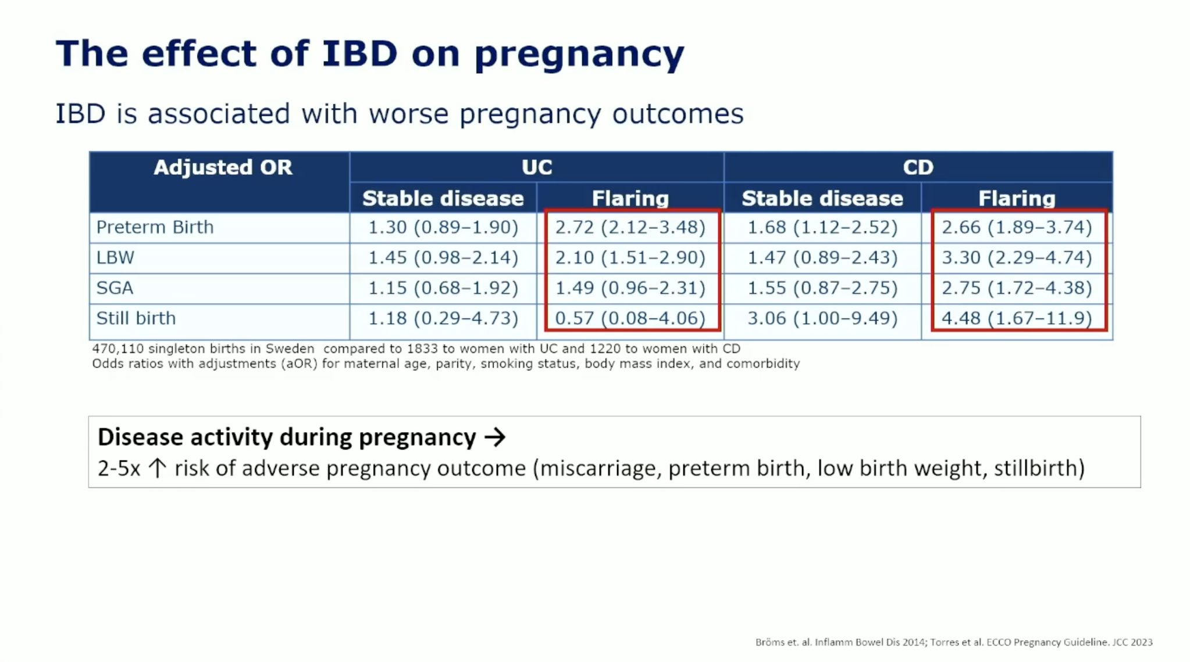

Slide 13
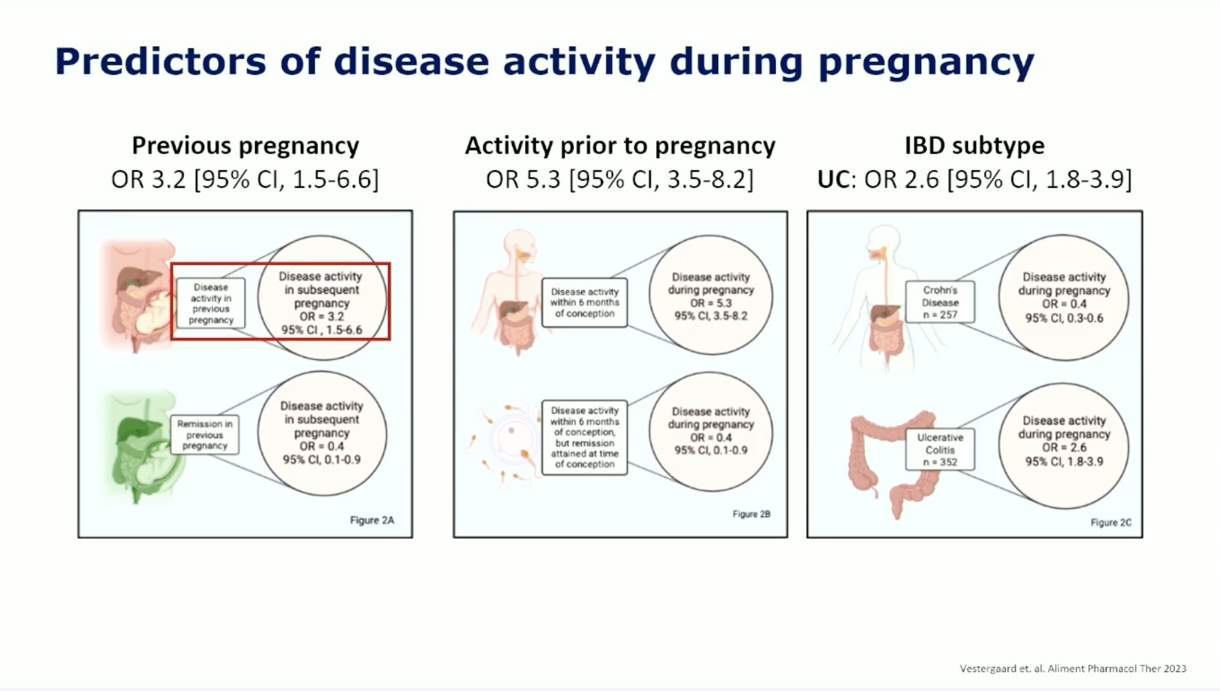

Slide 14
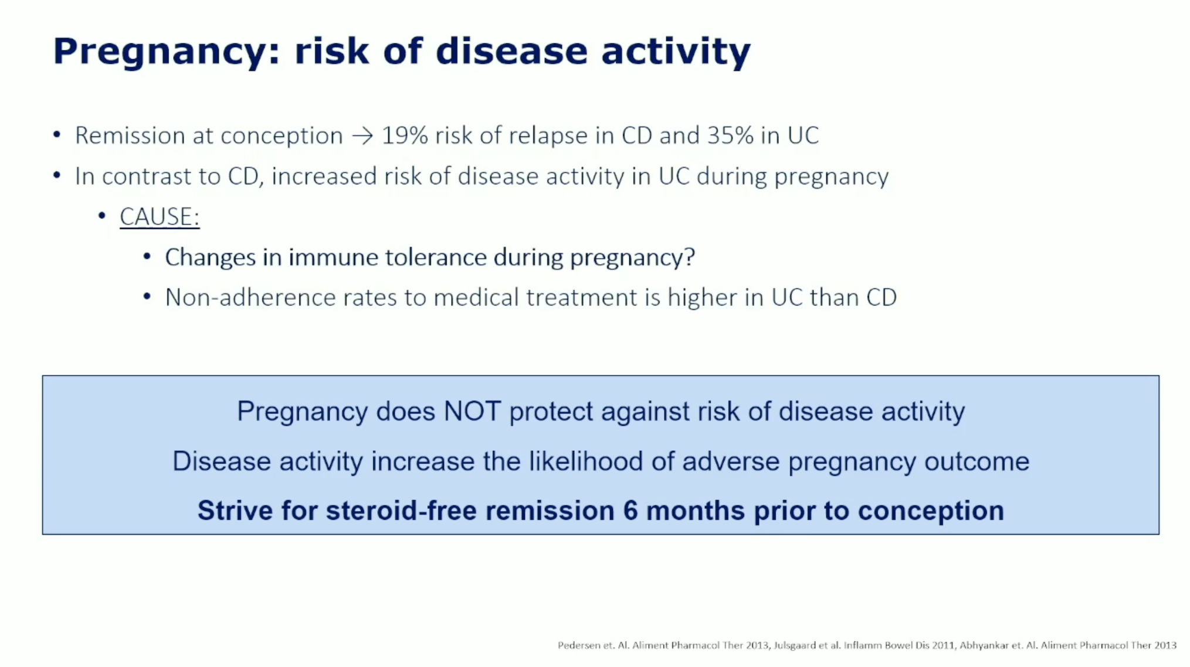

Slide 15
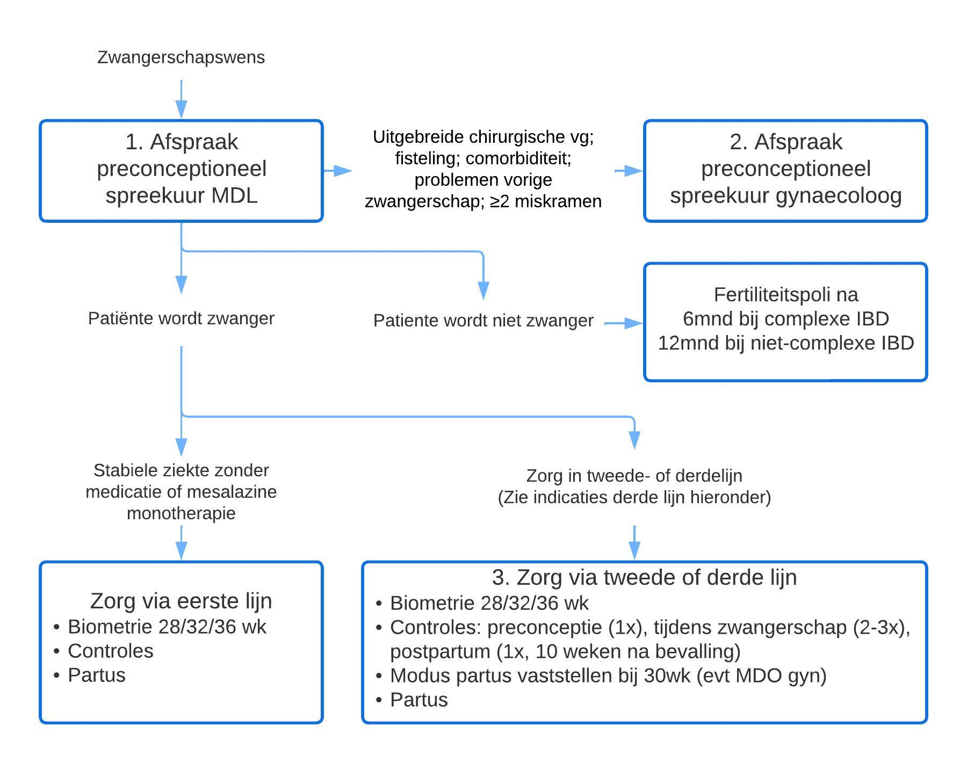
IBDnorth zwangerschapsprotocol

Slide 16
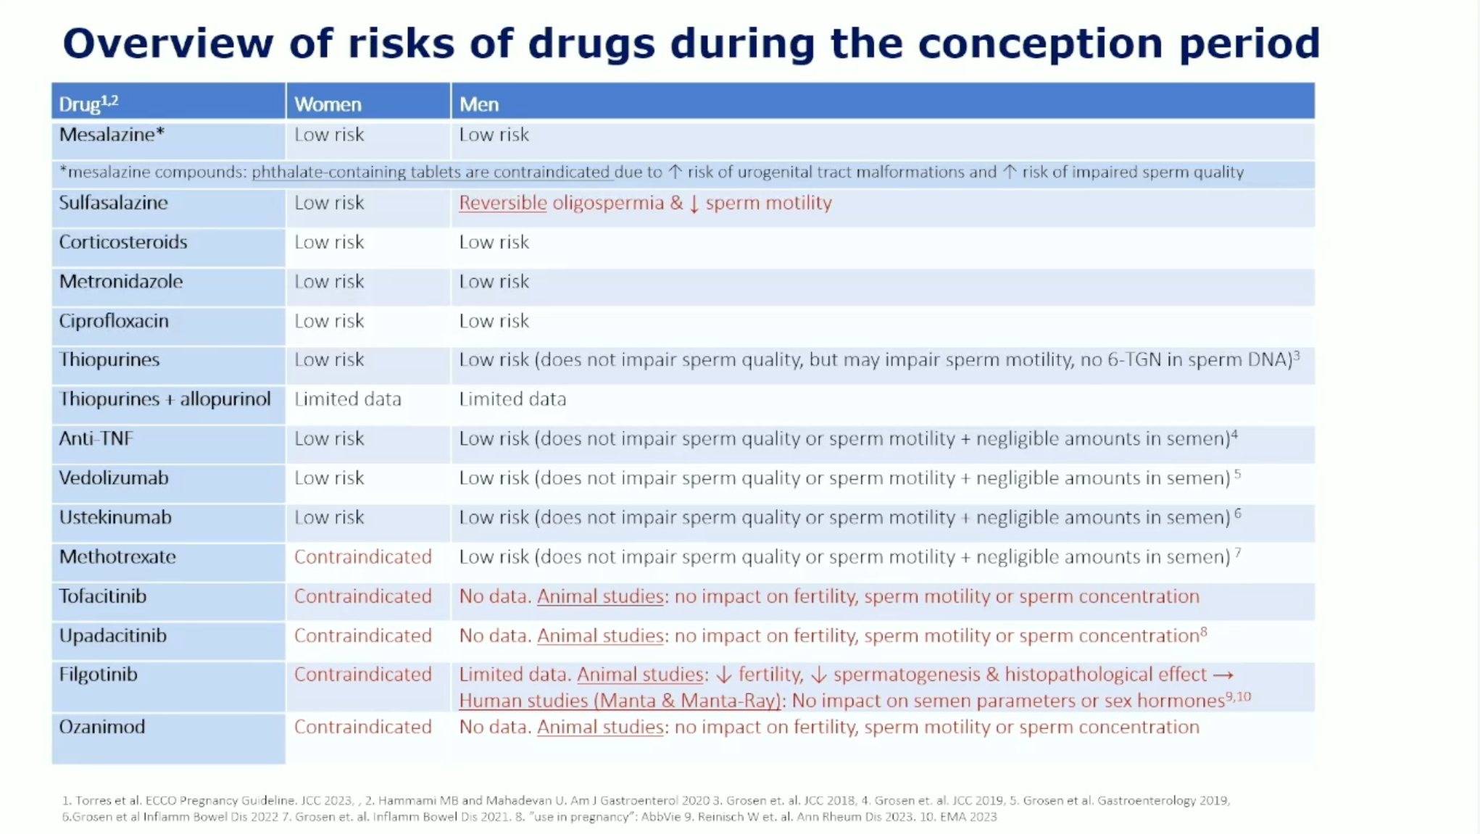

Slide 17
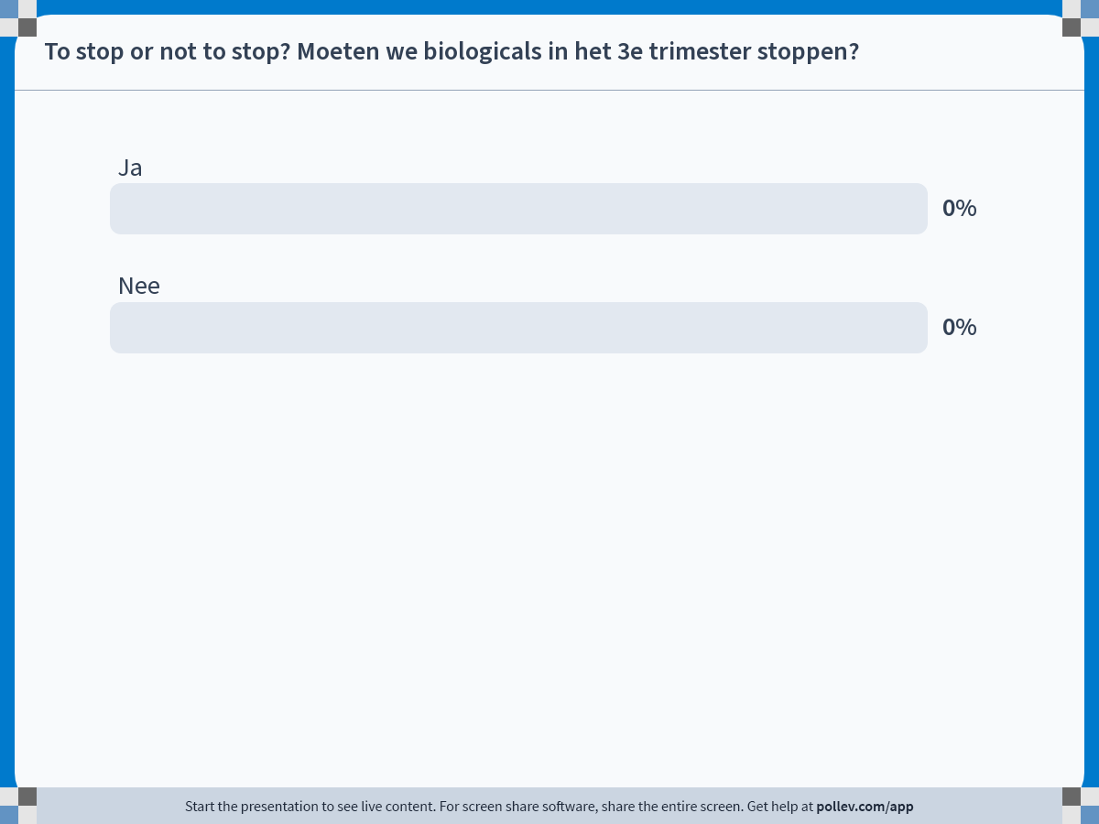
Notes:
Do not modify the notes in this section to avoid tampering with the Poll Everywhere activity.
More info at polleverywhere.com/support
To stop or not to stop? Moeten we biologicals in het 3e trimester stoppen?
https://www.polleverywhere.com/multiple_choice_polls/bM8nfYSkePMuPLu8ZsPg5?state=opened&flow=Default&onscreen=persist

Slide 18
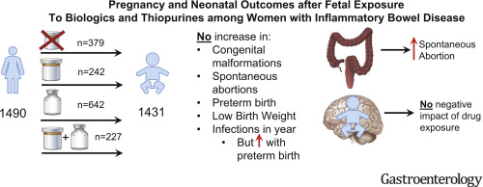
Infants of mothers receiving thiopurines or combination therapy had significantly increased birth weight.
There is no strong rationale to withhold biologic therapy in any pregnant IBD patient based on available evidence from PIANO and other international studies.
Notes:
Discontinuation of a biologic in the third trimester was not associated with an increased risk of subsequent flare postpartum

Slide 19
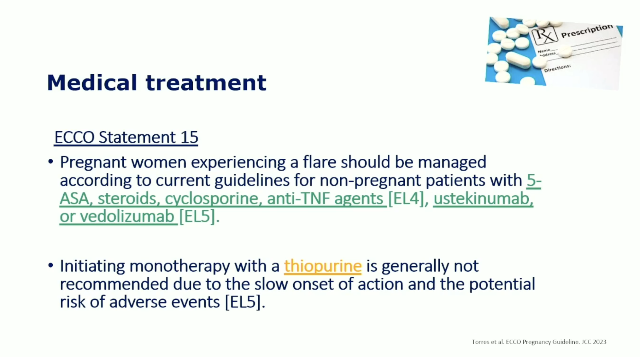
Flare

Slide 20
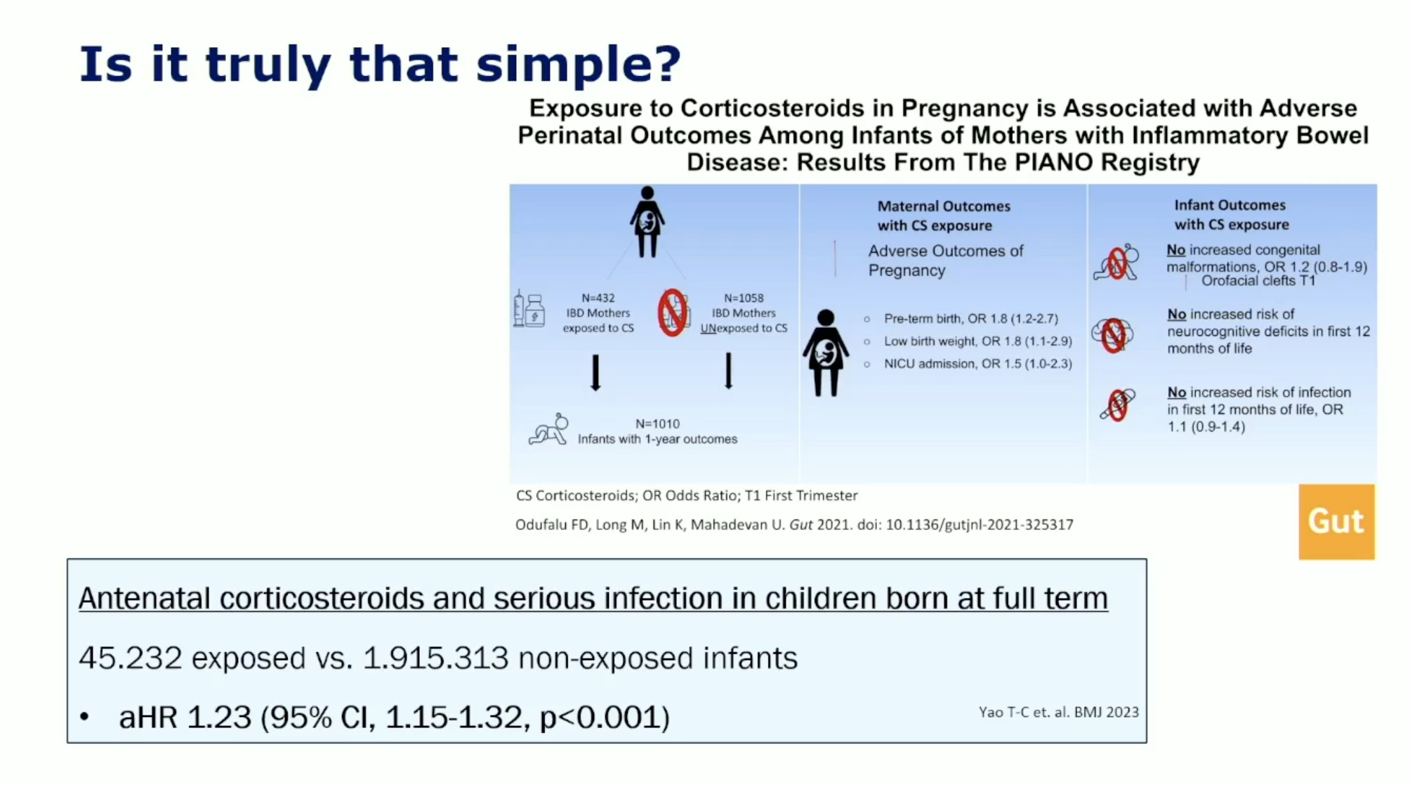

Slide 21
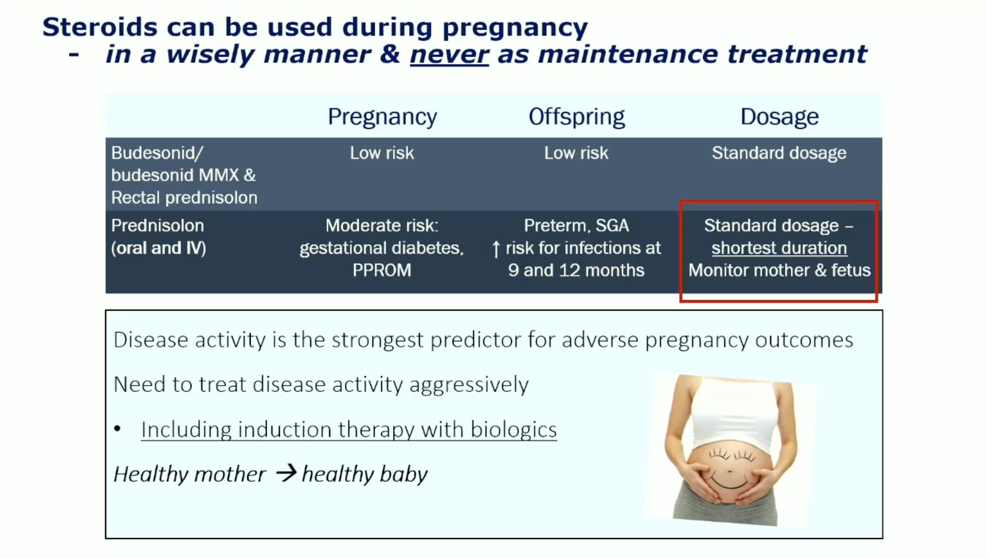

Slide 22
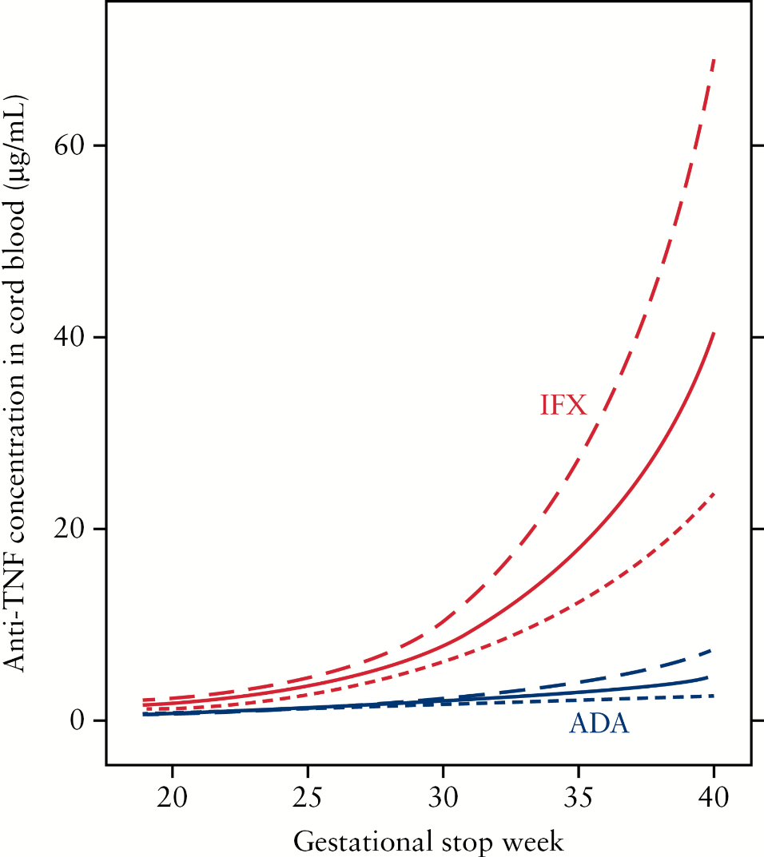
Spiegels anti-TNF te meten in navelstreng bloed
Anti-TNF Levels in Cord Blood at Birth are Associated with Anti-TNF Type
Kanis et al.
J Crohns Colitis. 2018;12(8):939-947. doi:10.1093/ecco-jcc/jjy058

Slide 23
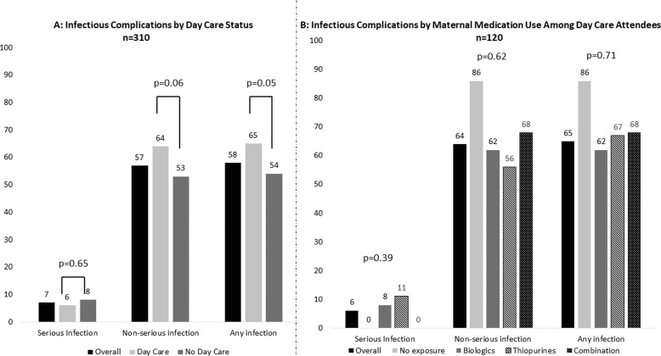
Post-partum
UC; beducht voor postpartum exacerbaties (40% vs 19%)
CD; geen verhoogd risico op exacerbaties, zelfs daling exacerbaties risico 5 jaar postpartum.
Notes:
Oestrogenen en progesteron nemen toe tijdens de zwangerschap, kan de bacteriële translocatie verlagen en zo de IBD activiteit.

Slide 24
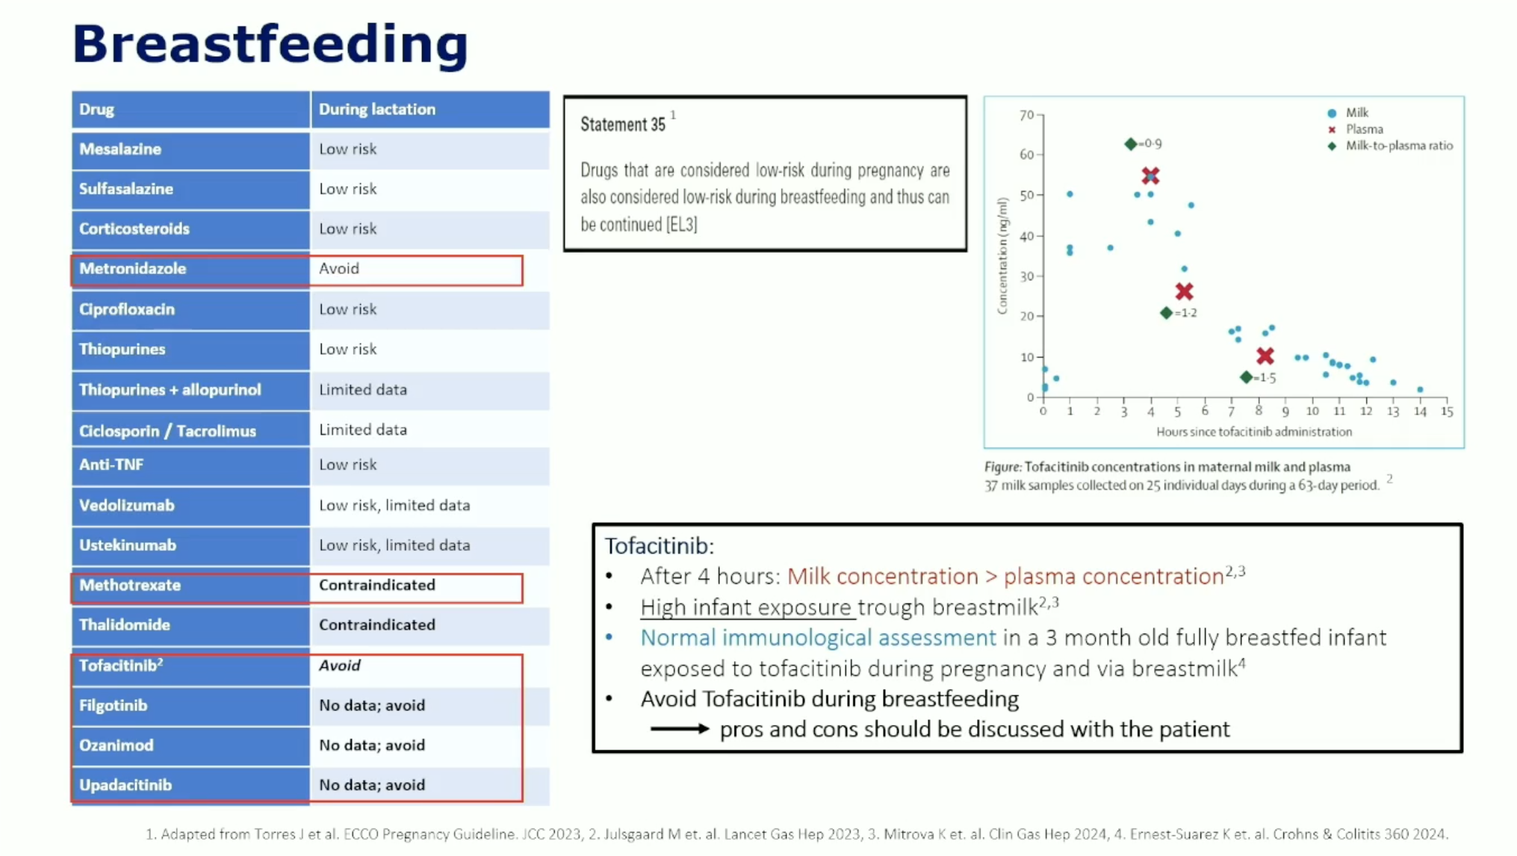
Notes:
Vaccinaties noemen. Rota ~ 12 weken

Slide 25
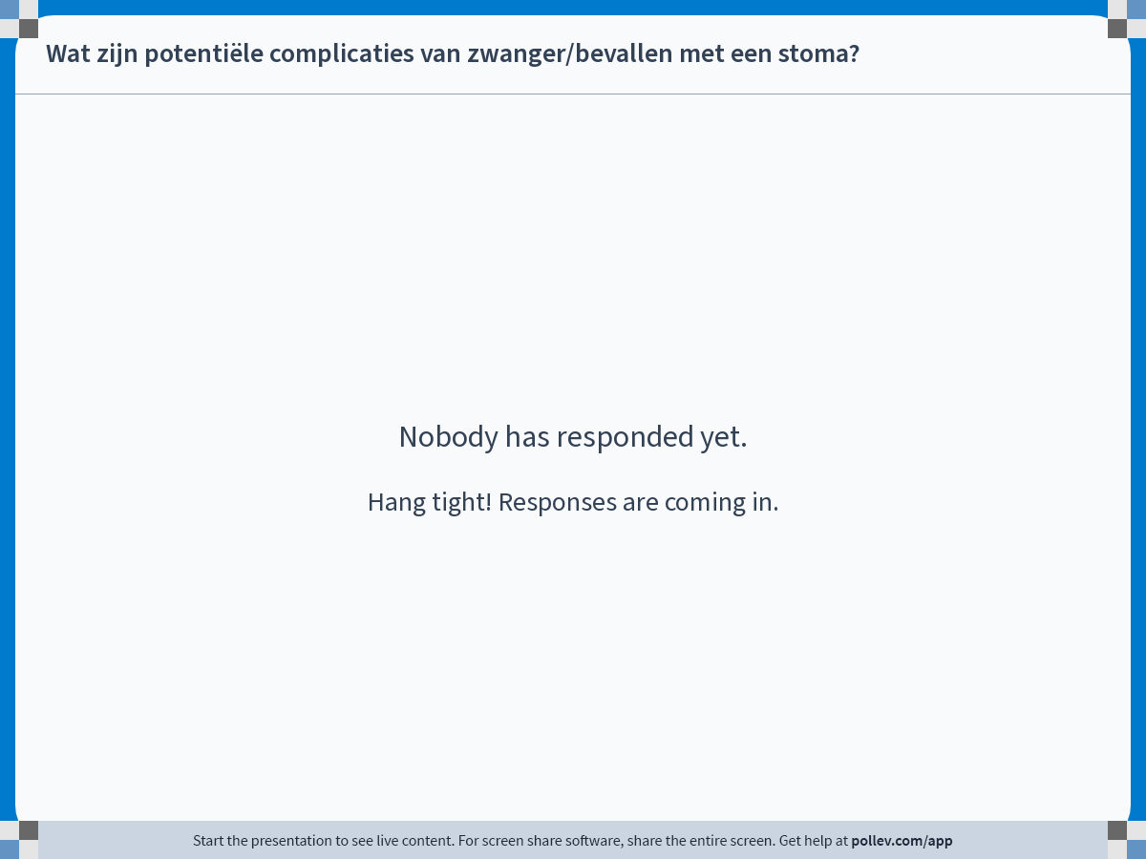
Notes:
Do not modify the notes in this section to avoid tampering with the Poll Everywhere activity.
More info at polleverywhere.com/support
Wat zijn potentiële complicaties van zwanger/bevallen met een stoma?
https://www.polleverywhere.com/free_text_polls/e5iZcK8XeVZSLuiGXbnxZ

Slide 26
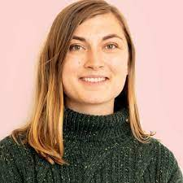



Pregnancy for IBD-patients with an ostomy is feasible, but is associated with complications
D.G. Bouwknegt, A.H.C. van der Weide, G. Dijkstra, W. van Dop, M.M.C. Hirdes, R.L. Goetgebuer, L. Oldenburg, J.R. Prins, F.J. Hoogenboom, C.J. van der Woude, M.C. Visschedijk
on behalf of the Dutch Initiative on Crohn and Colitis
Dept. of Gastroenterology and Hepatology, UMCG Groningen and ErasmusMC Rotterdam
Dept. of Colorectal Surgery, UMCG, Groningen, The Netherlands
Dept. of Obstetrics and Gynaecology, UMCG, Groningen, The Netherlands

Slide 27
66.1% ostomy-related complications
56 live births in 46 patients (49.2% UC; 50.8% CD)
End ileostomy was the most prevalent stoma-type (77.0%)
Complications during pregnancy and postpartum* (n=56) | Pregnancies, n [% of cases]
Obstruction | 16 [28.6]
Parastomal herniation | 12 [21.4]
Prolapse | 9 [16.1]
Minor complications | 19 [38.0]
Total, n [% of cases] | 37 [66.1]
Surgery during pregnancy | Pregnancies, n [% of cases]
Indication obstruction | 2 [3.6]
Indication prolapse | 2 [3.6]
Total | 4 [7.1]
Postpartum surgery* | Pregnancies, n [% of cases]
Indication parastomal herniation | 4 [7.1]
Indication prolapse | 1 [1.8]
Total | 5 [8.9]
*<1 year postpartum
D.G. Bouwknegt

Slide 28



Pregnancy outcomes
Caesarean section rate in IBD patients
 | 32.5% [5.7% – 80%]
 | 25.0%
Cohort | 46.4%
Neonatal outcome (n=56) | Pregnancies, n [% of cases]
Premature (<37 weeks) | 9 [16.1]
Low birthweight (<2500gr) | 9 [16.1]
Small for gestational age (<10th percentile) | 6 [10.7]
DDD
20 maart 2024
9.30 uur Brabant-zaal
D.G. Bouwknegt

Slide 29
Take home message
Healthy mother = healthy baby
Treat active disease, if necessary with biologicals
Use steroids in wisely manner
Multidisciplinary approach

Slide 30
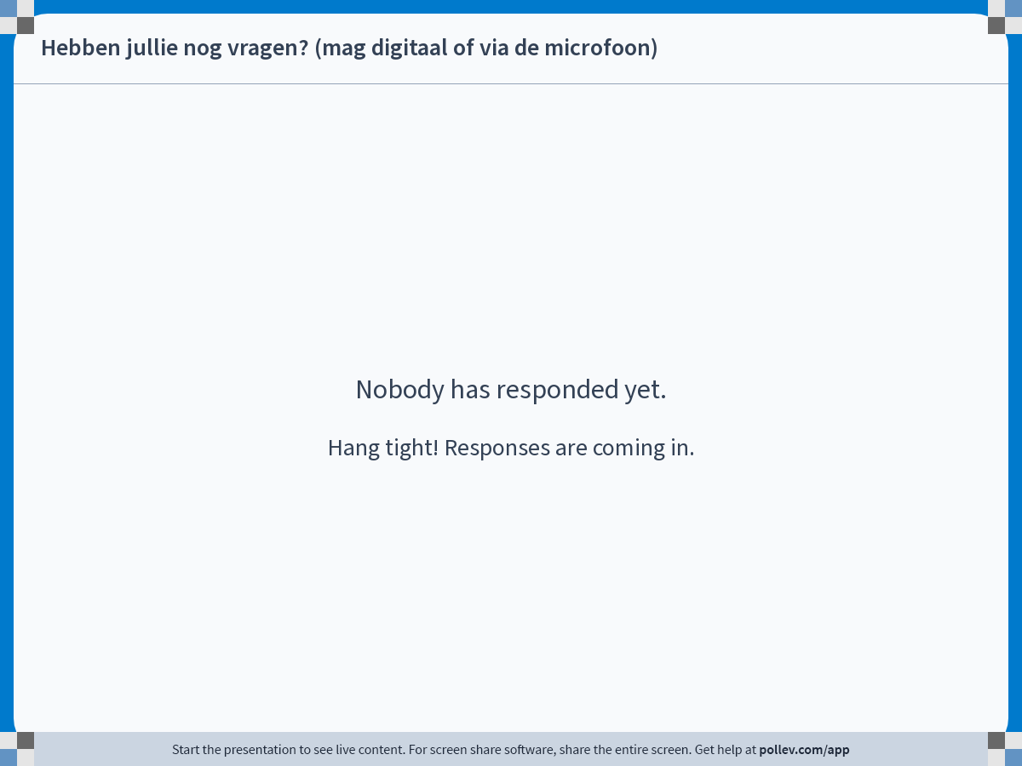
Notes:
Do not modify the notes in this section to avoid tampering with the Poll Everywhere activity.
More info at polleverywhere.com/support
Hebben jullie nog vragen? (mag digitaal of via de microfoon)
https://www.polleverywhere.com/free_text_polls/ZCBKm5o99SZTCxhhl8d8T

Slide 31
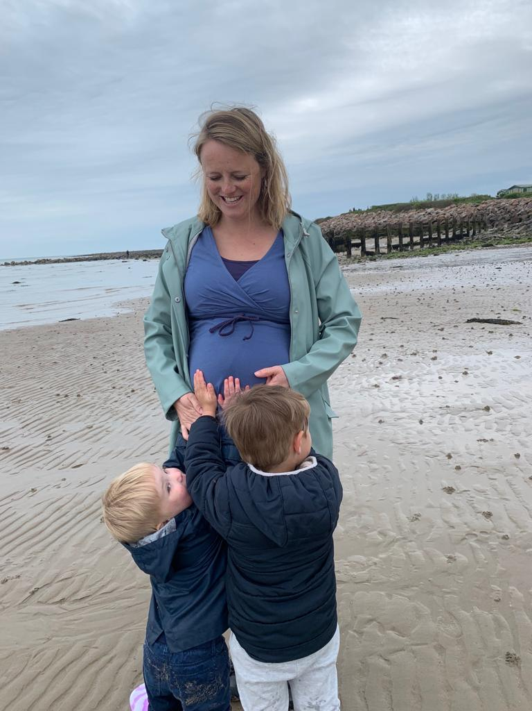
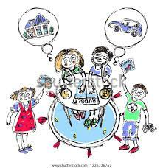
Planning → Planner

Slide 32
De man
Sulfasazine reduceert sperma motiliteit (reversibel)
MTX reversibele oligospermie.
Actieve ziekte of recent gesteld diagnose kan zorgen wel voor delay ~seksuele activiteit, sperma kwaliteit of beide.
Mannen met IBD gebruiken meer medicatie tegen erectiele dysfunctie, dit is significant door operatiehistorie. (Friedman Am J Gastorenterol 2018)

Slide 33
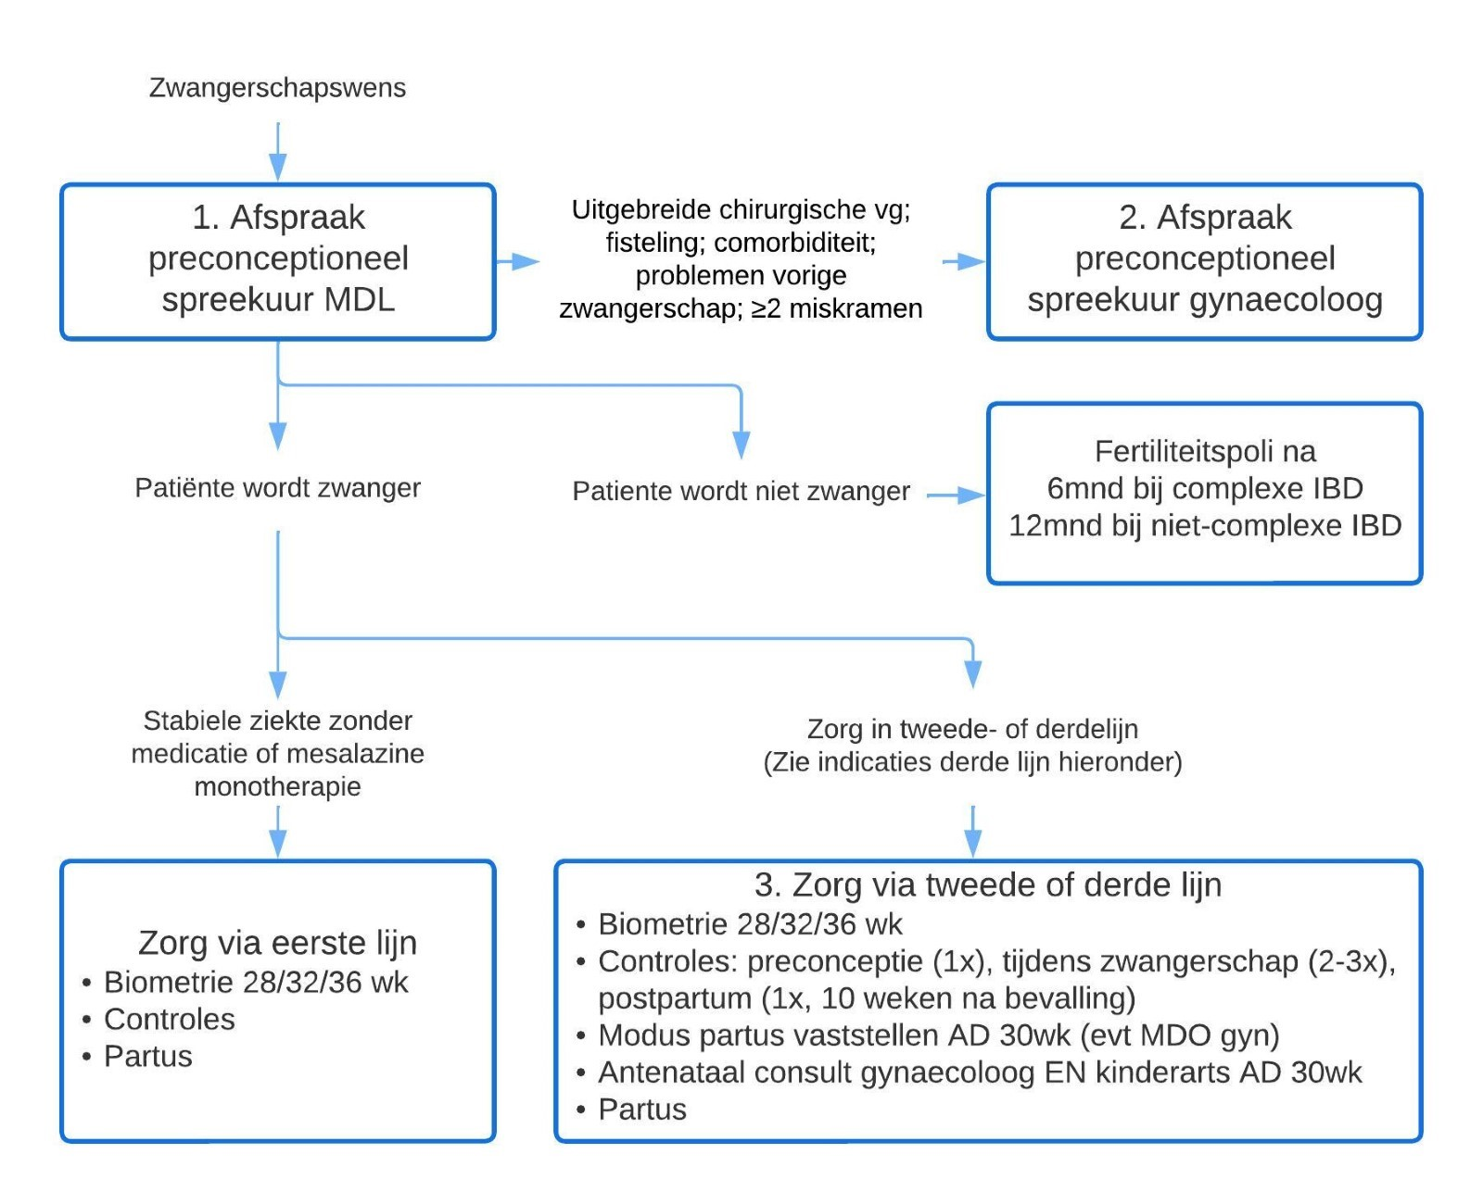

Slide 34
Preconceptie poli
Preconceptie adviezen:
Vruchtbaarheid
Ziekteactiviteit (minimaal 6 maanden rustig, dan groenlicht)
Medicatie tijdens zwangerschap
Borstvoeding
Modus Partus
Erfelijkheid
Maar ook: foliumzuur gebruik en roken
Notes:
Risico op opvlamming tijdens de zwangerschap is 14-22% in CD en 26-35% in UC (ws door pro-inflammatoire cytokines door de placenta, activeren UC). Actieve ziekte tijdens de conceptie hebben 2 keer zo groot risico op opvlamming. Bij actieve ziekte tijdens conceptie 26-65% in CD en 33-79% in UC opvlamming.

Slide 35
Preconceptie poli
N=155 vs N=162 (controle)
Minder exacerbaties (onafhankelijk van eerdere ziekteactiviteit), (aOR, 0.51)
Medicatietrouwer (aOR, 5.69)
Rookten minder (aOR, 4.63)
Minder baby’s met te laag geboortegewicht (aOR, 0.08)
De Lima, Clin Gastro Hep 2016

Slide 36
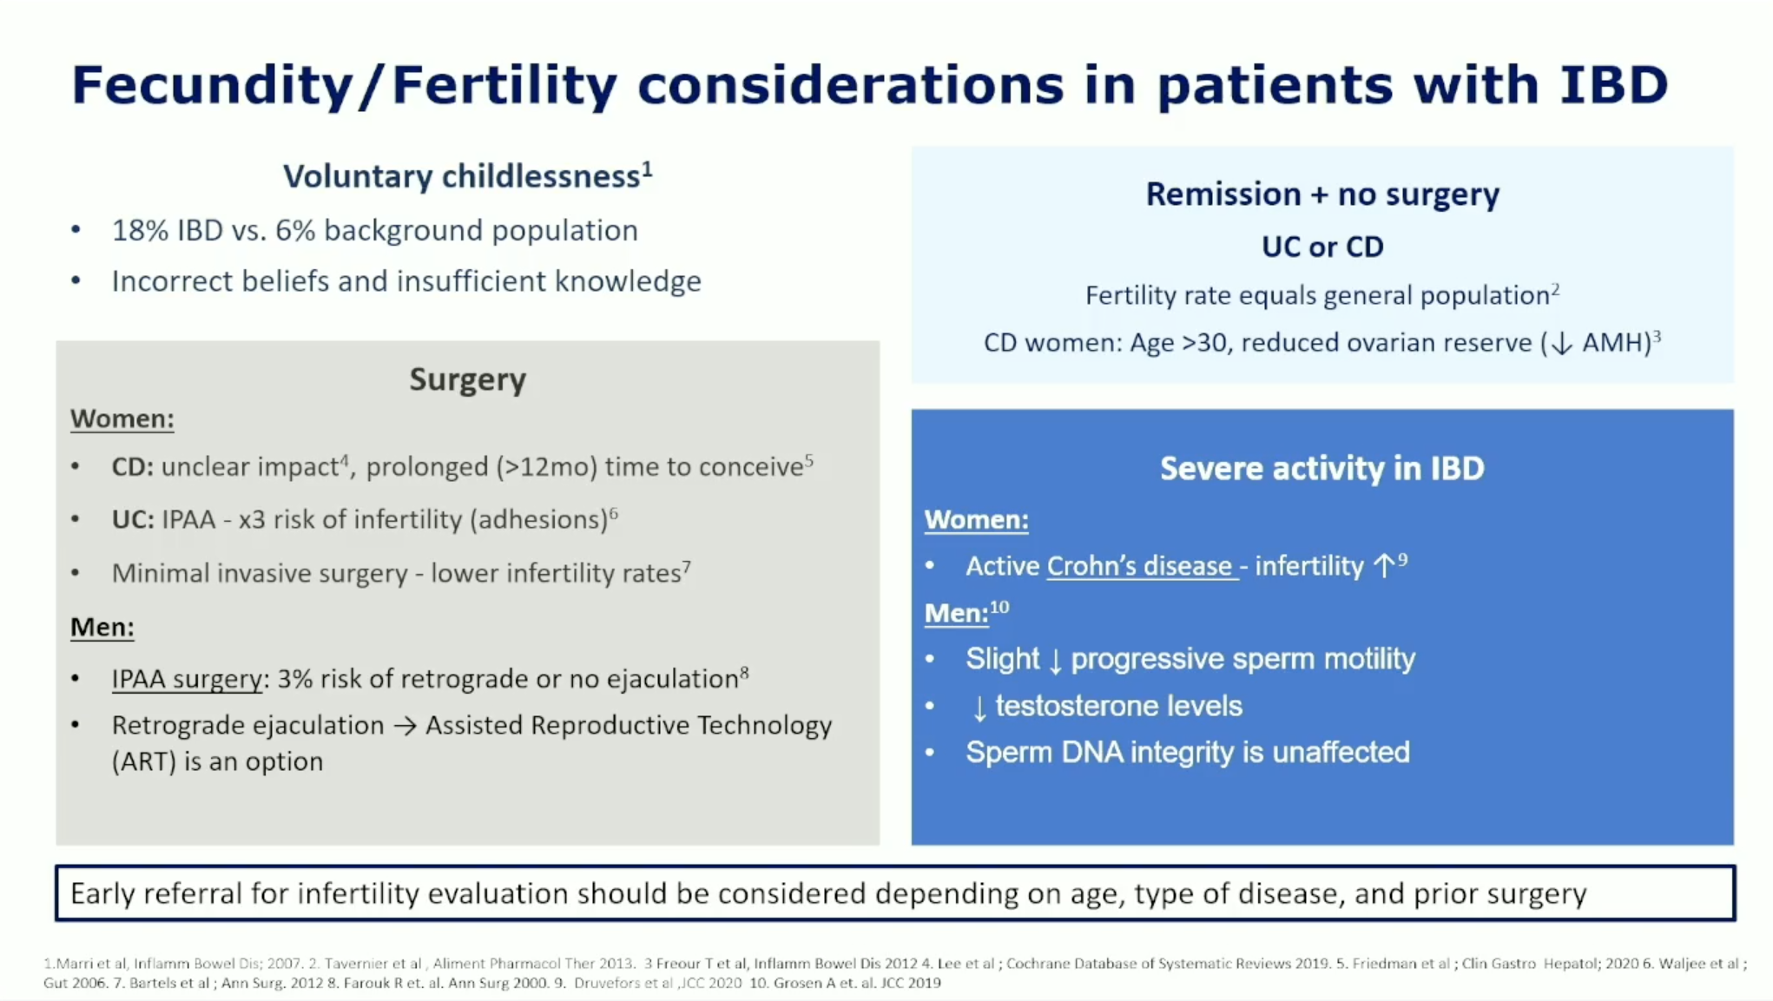

Slide 37
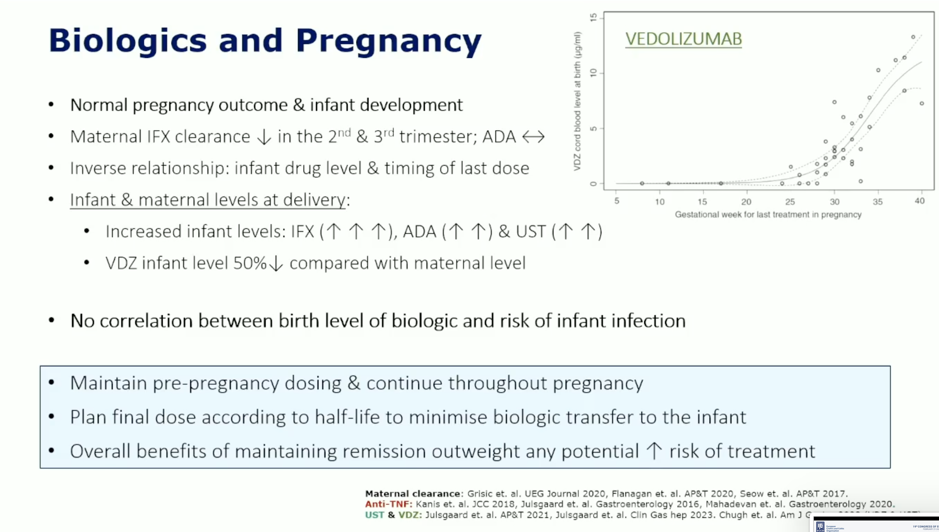

Slide 38
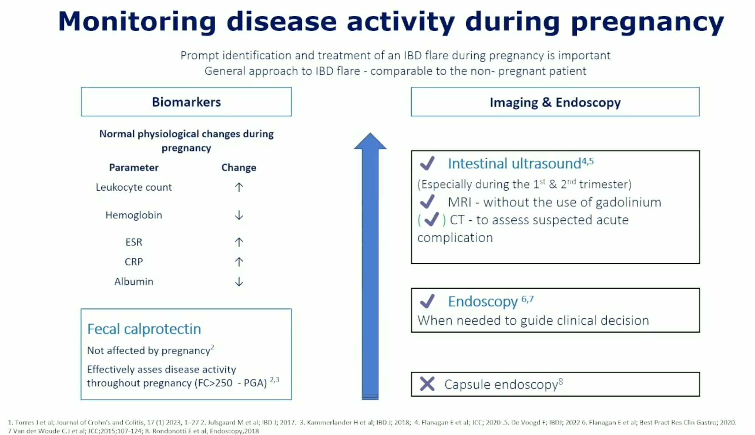

Slide 39
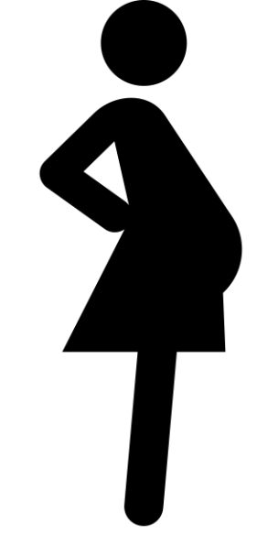
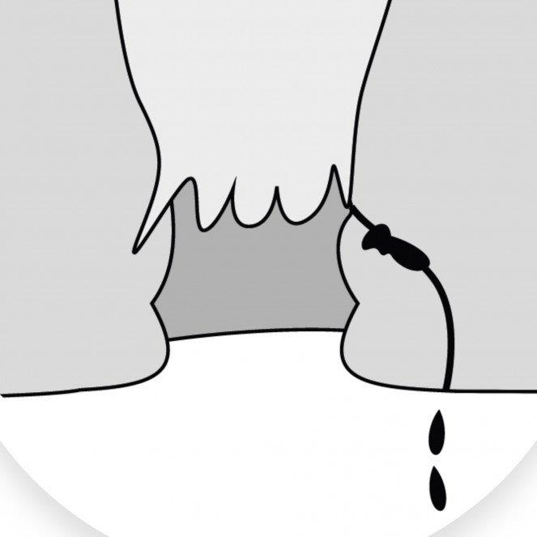

Background: ECCO guidelines
Active: indication caesarean section
Inactive: multidisciplinary, governed by obstetric indication
Crohn’s disease + perianal fistulas

Slide 40
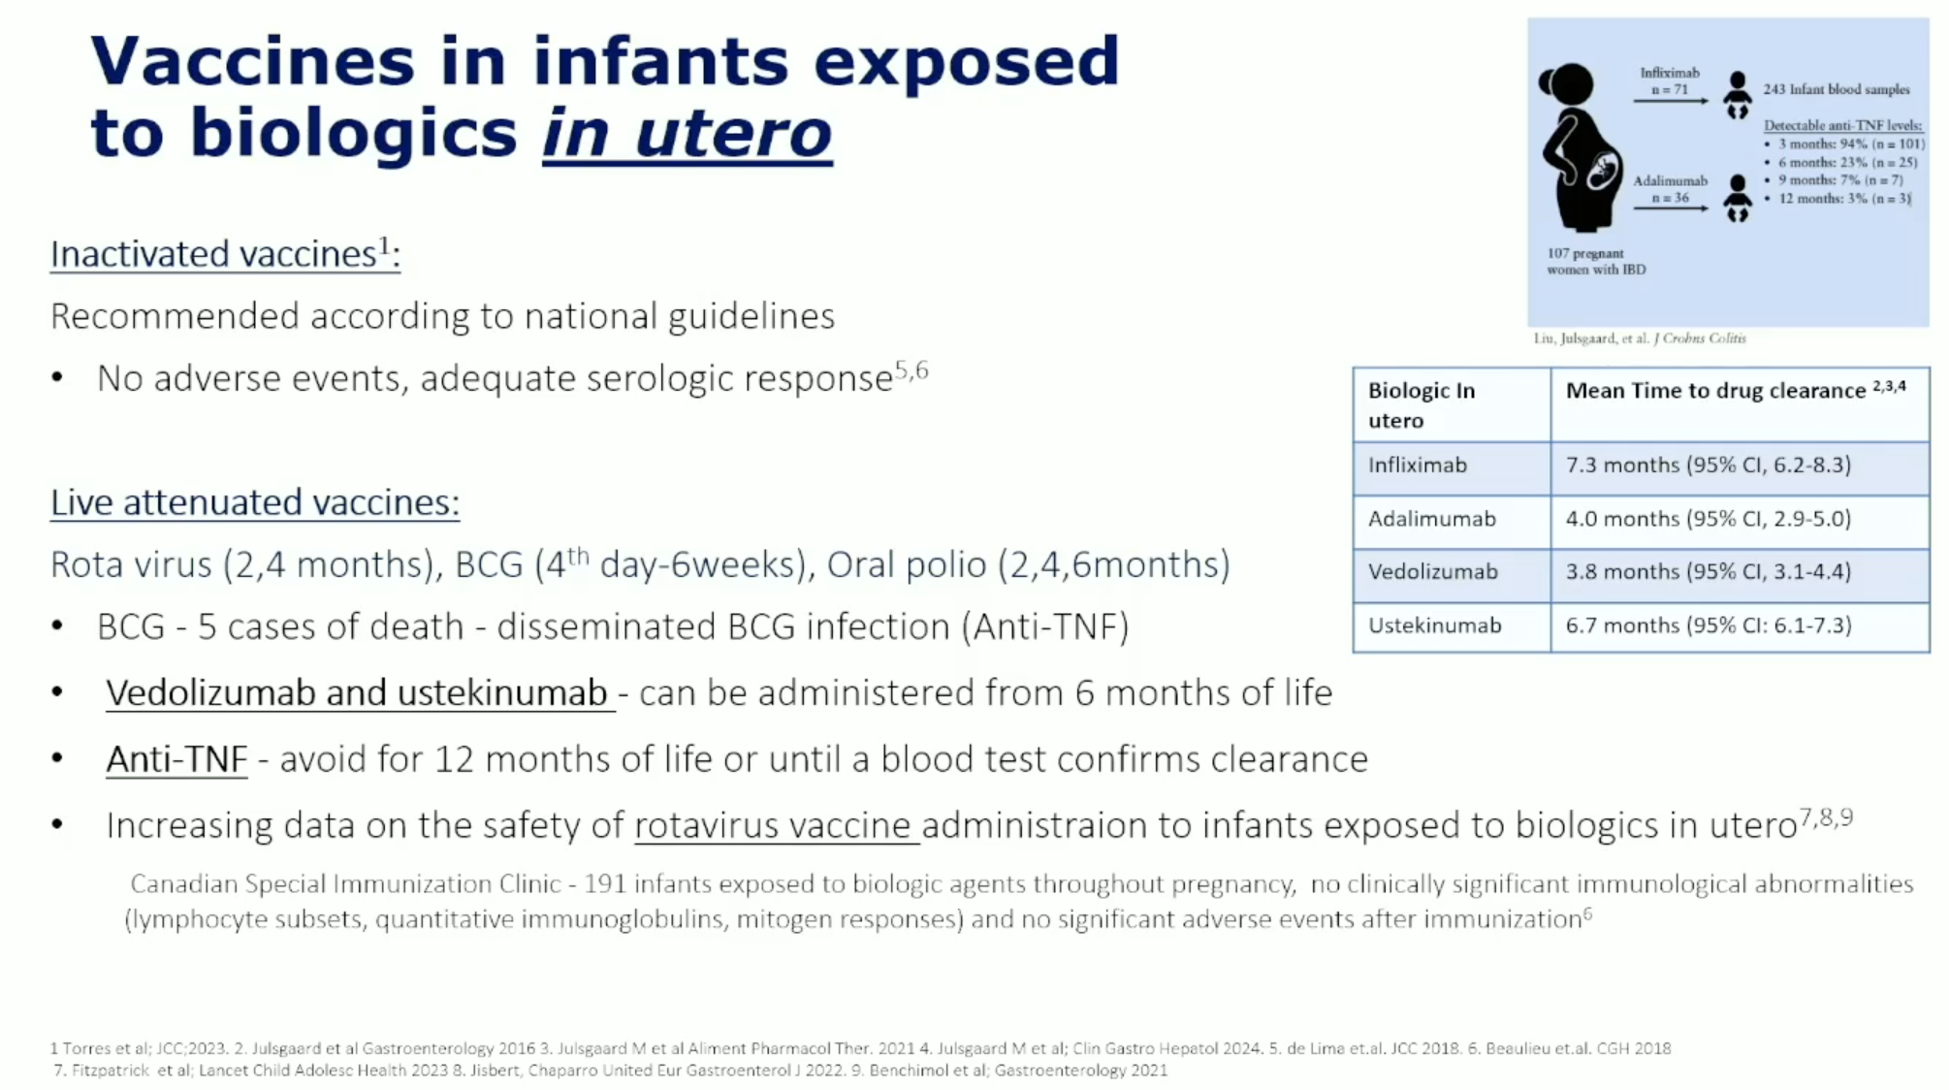

Slide 41
