Slide 1


Endoscopy in Pregnancy
Erasmus MC
P.J.F. de Jonge
Erasmus MC Rotterdam

Slide 2

Case
27 year old female
24 wk gestational age
Biliary colic's, opioid dependent
SIRS negative
Abnormal LFT, increased bilirubin level
Abdominal ultrasound: suspicion of choledocholithiasis
ERCP?

Slide 3
Endoscopy and Pregnancy
Is it safe to perform endoscopy during pregnancy?
Is there an optimal time window for endoscopy during pregnancy?
Are there specific procedural considerations for endoscopy during pregnancy?

Slide 4
Endoscopy and Pregnancy
Is it safe to perform endoscopy during pregnancy?
Is there an optimal time window for endoscopy during pregnancy?
Are there specific procedural considerations for endoscopy during pregnancy?

Slide 5
Why could there be an increased risk?
Fetus: sensitive to maternal hypoxia and hypotension
  Maternal over sedation: hypoventilation or hypotension
  Maternal positioning: inferior vena cava compression by gravid uterus
  Teratogenesis (medication or ionizing radiation exposure)
  Premature birth
Mother: risk of aspiration
  Lower LES pressure spanning oiv progesteron en oestrogeen
  Stomach positioned more horizontally
  Delayed gastric emptying

Slide 6
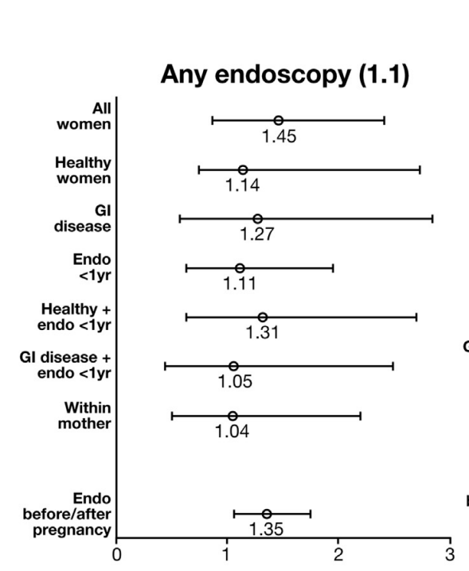
Safety of Endoscopy during Pregnancy
Swedish population-based cohort study
3052 pregnancies exposed to endoscopy
  2025 UGI endoscopies
  1109 LGI endoscopies
  58 ERCPs
Controls: non exposed pregnancies
ARR: stillbirth, SGA and preterm birth
Stillbirth
Ludvigsson et al. Gastroenterology 2017

Slide 7
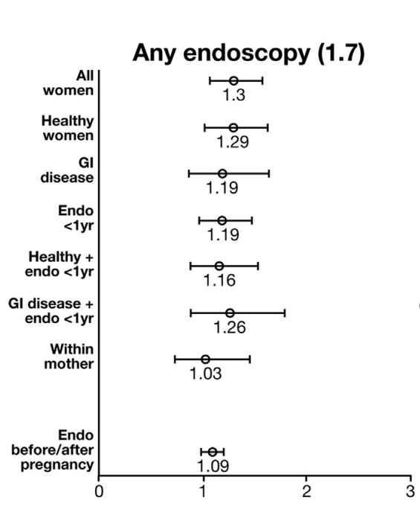
Safety of Endoscopy during Pregnancy
Swedish population-based cohort study
3052 pregnancies exposed to endoscopy
  2025 UGI endoscopies
  1109 LGI endoscopies
  58 ERCPs
Controls: non exposed pregnancies
ARR: stillbirth, SGA and preterm birth
SGA
Ludvigsson et al. Gastroenterology 2017

Slide 8
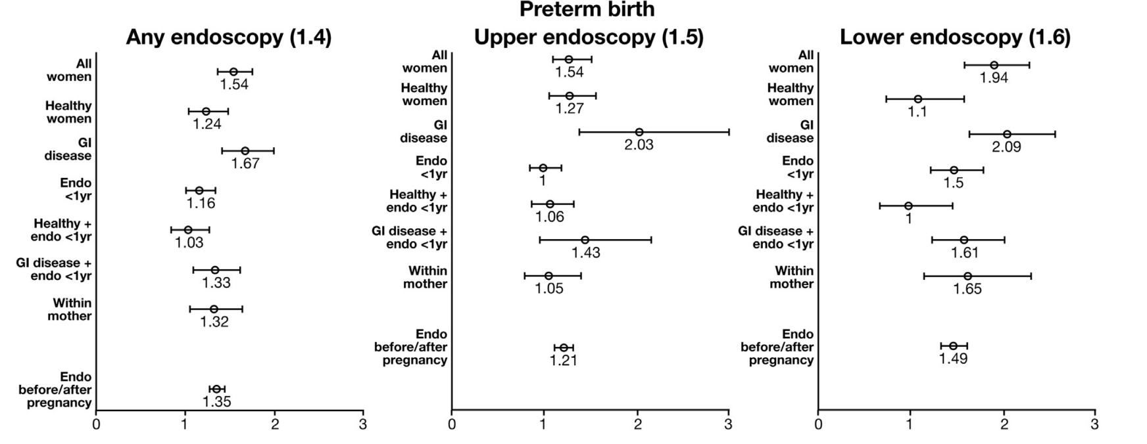
Safety of Endoscopy during Pregnancy
Swedish population-based cohort study
3052 pregnancies exposed to endoscopy
  2025 UGI endoscopies
  1109 LGI endoscopies
  58 ERCPs
Controls: non exposed pregnancies
ARR: stillbirth, SGA and preterm birth
Preterm Birth
Ludvigsson et al. Gastroenterology 2017

Slide 9
Safety of Endoscopy during Pregnancy
Preterm Birth
Ludvigsson et al. Gastroenterology 2017

Slide 10
Safety of Endoscopy during Pregnancy
Preterm Birth
Ludvigsson et al. Gastroenterology 2017

Slide 11
Safety of Endoscopy during Pregnancy
Preterm Birth
Ludvigsson et al. Gastroenterology 2017

Slide 12
Safety of Endoscopy during Pregnancy
Swedish population-based cohort study
3052 pregnancies exposed to endoscopy
  2025 UGI endoscopies
  1109 LGI endoscopies
  58 ERCPs
Controls: non exposed pregnancies
ARR: stillbirth, SGA and preterm birth
Conclusions:
Increased risk of preterm birth and SGA
No increased risk of congenital malformation or stillbirth
Risks are small and likely due to disease activity
Ludvigsson et al. Gastroenterology 2017

Slide 13
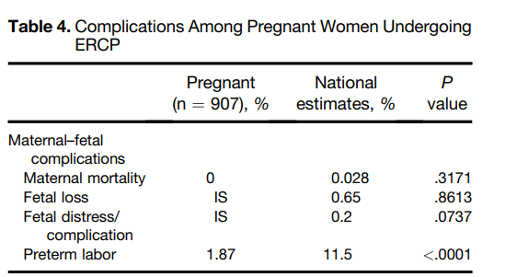
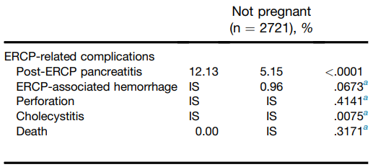
Safety of ERCP during Pregnancy
Retrospective matched-cohort study
907 pregnancies with ERCP
Controls: 2721 non pregnant ERCP
Complications:
PEP, bleeding, perforation
Indamar et al. Gastroenterology 2016

Slide 14
Safety of ERCP during Pregnancy
Retrospective matched-cohort study
907 pregnancies with ERCP
Controls: 2721 non pregnant ERCP
Complications:
PEP, bleeding, perforation
Indamar et al. Gastroenterology 2016

Slide 15
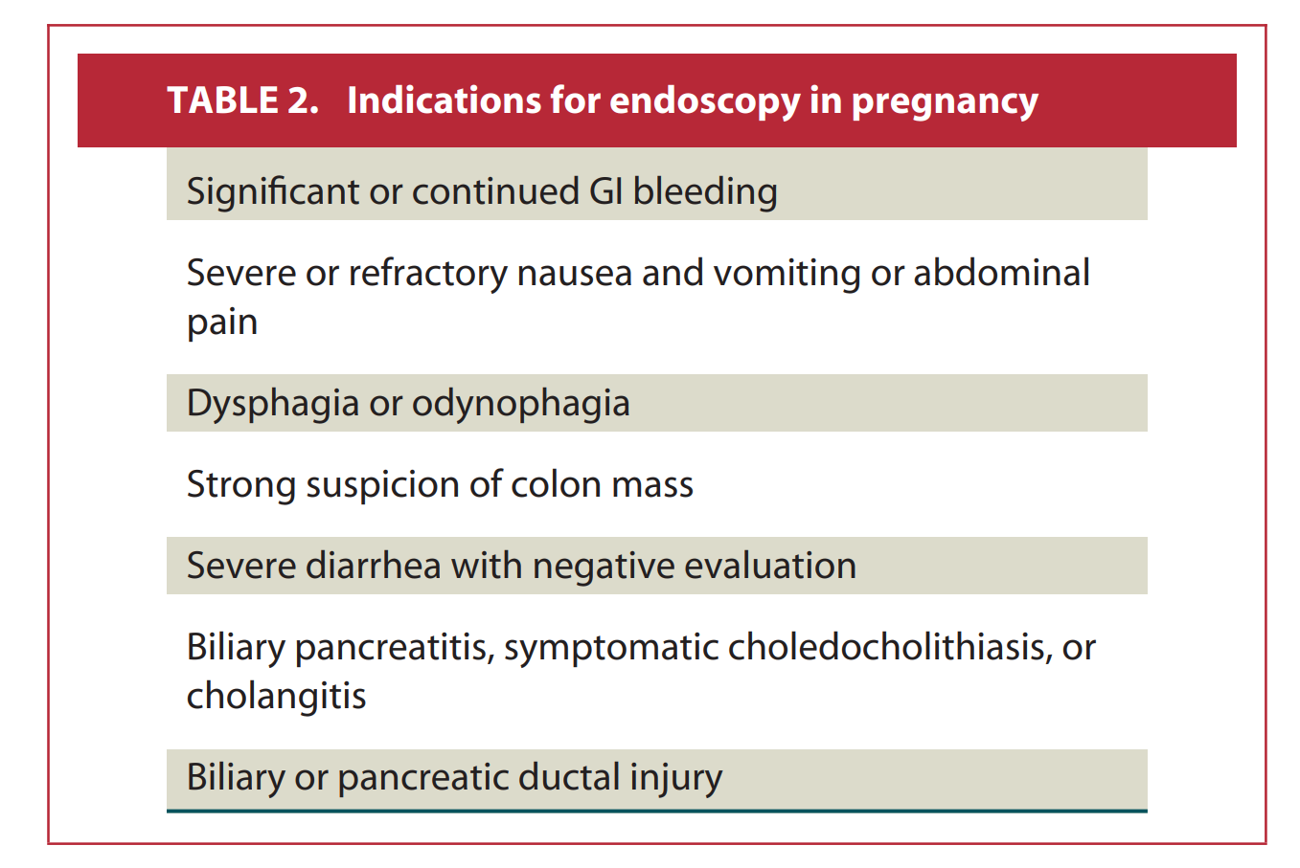
Have a Strong Indication!
Consider:
  Is there an alternative non endoscopic management?
  If not, can the timing of endoscopy be postponed?
Justified when it is clear that failure to perform the procedure could expose the fetus and/or mother to harm
Obtain informed consent:
  Risks to the fetus as well as to the mother
ASGE Guideline 2012

Slide 16
Endoscopy and Pregnacy
Is it safe to perform endoscopy during pregnancy?
Is there an optimal time window for endoscopy during pregnancy?
Are there specific procedural considerations for endoscopy during pregnancy?

Slide 17
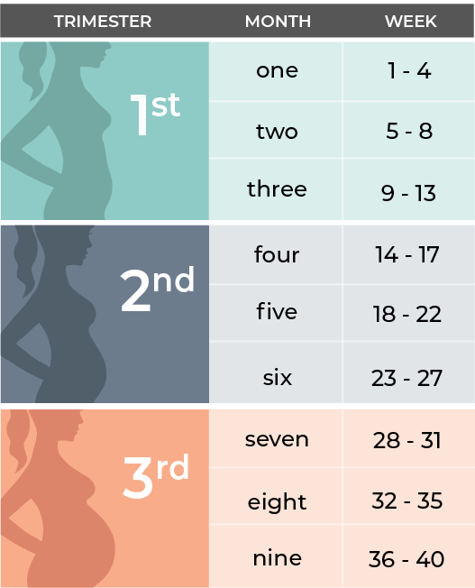
Optimal Time Window for Endoscopy
Traditionally:
  If possible, perform endoscopy in 2nd trimester
  1st trimester: organogenesis
  3rd trimester: volume

Slide 18
Optimal Time Window for Endoscopy
Traditionally:
  If possible, perform endoscopy in 2nd trimester
  1st trimester: organogenesis
  3rd trimester: volume
However, no differences in outcome of pregnancy between trimesters
  Ludvigsson et al. 2017
  De Lima et al. 2015

Slide 19
Optimal Time Window for Endoscopy
Urgent endoscopy:
in every trimester
Semi-elective endoscopy:
preferably in second trimester
Elective procedure:
after delivery

Slide 20
Endoscopy and Pregnancy
Is it safe to perform endoscopy during pregnancy?
Is there an optimal time window for endoscopy during pregnancy?
Are there procedural considerations for endoscopy during pregnancy?

Slide 21
Endoscopy and Pregnancy
Is it safe to perform endoscopy during pregnancy?
Is there an optimal time window for endoscopy during pregnancy?
Are there procedural considerations for endoscopy during pregnancy?
- Drugs
- Sedation
- Endoscopy specific interventions

Slide 22
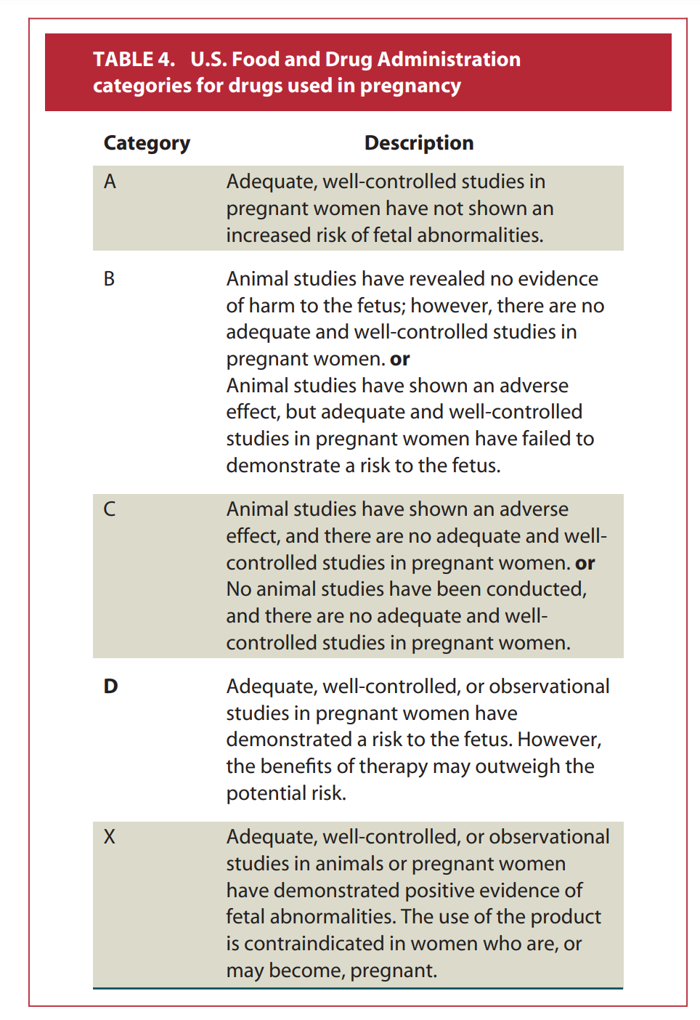
General procedural considerations: drugs
There are no category A drugs used for endoscopy
For endoscopic procedures category B, and when necessary category C are recommended
Category D drugs may be used when benefits outweigh risks
Categories of limited use in determining safety due to one-time use

Slide 23
Sedation and Endoscopy
General rules:
1. Titrate gently administered level of anesthetic drugs, lowest effective dose
  Increased risk of aspiration and potentially difficult airway
  ` (swelling oropharyngeal tissue, decreased caliber of glottic opening)
  Hypoventilation and hypotension
2. Consultation with an obstetrician
  Consider fetal heartbeat monitoring, > 24-26 wks GA
  Support in case of pregnancy related complications

Slide 24

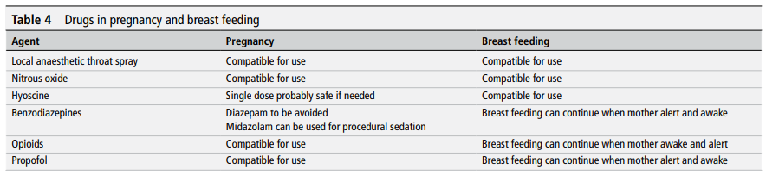
Moderate Sedation and Endoscopy
For most procedures, the level of sedation should be anxiolysis or moderate sedation
Midazolam
Fentanyl
Lidocaine spray
Sidhu et al. Gut 2024

Slide 25
Moderate Sedation and Endoscopy
For most procedures, the level of sedation should be anxiolysis or moderate sedation
Midazolam Flumazenil
Fentanyl Naloxon
Lidocaine spray
Sidhu et al. Gut 2024

Slide 26
Deep Sedation and Endoscopy
Deep sedation for patients who are difficult to sedate, and/or therapeutic endoscopy
Propofol
Ketamine
Deep sedation or general anesthesia?
No difference found on safety in pregnant patients undergoing diagnostic of minimally invasive procedures
Decision per case based on type of procedure, and patient specific risk factors
Conceptrichtlijn Anesthesie tijdens de zwangerschap januari 2024
Notes:
LES lagere spanning oiv progesteron en oestrogeen
Maag in meer horizontale positive
Geen vertraagde lediging echter tijdens zwangerschap

Slide 27
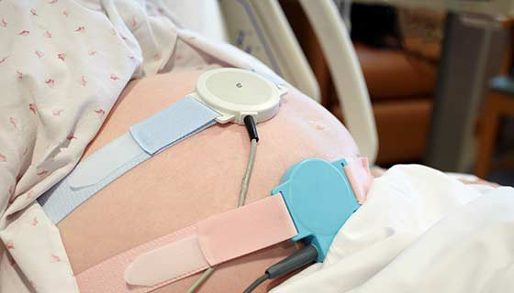
Monitoring of the Fetus
Rationale
Early intervention in case of detoriation of fetal condition
When?
Expected changes in maternal hemodynamics
From 24-26 weeks of gestational age
How?
Pre, post endoscopy or intermittent registration of heart sounds
Continuous monitoring with CTG
Measure uterine contractions

Slide 28
Colonoscopy: Specific Considerations
Preparation:
PEG based bowel preparation is safe
Sodium phosphate contraindicated (fluid overload)
Positioning the patient:
Not in supine position in second and third trimester
Left lateral position, also after endoscopy when in recovery room!
Consider to place a wedge or pillow under the patients hip
Procedure:
External compression allowed (mild force and direct it away from the uterus)

Slide 29
ERCP: Specific Considerations
Radiation protection:
External shielding with lead paced under/above the pelvis and lower abdomen
However majority of radiation scatter occurs within the pregnant patient
Minimize amount of radiation:
Collimate the beam of area of interest
Use brief snapshots
Avoid taking hard copy x- ray films, these involve greater amounts of radiation

Slide 30
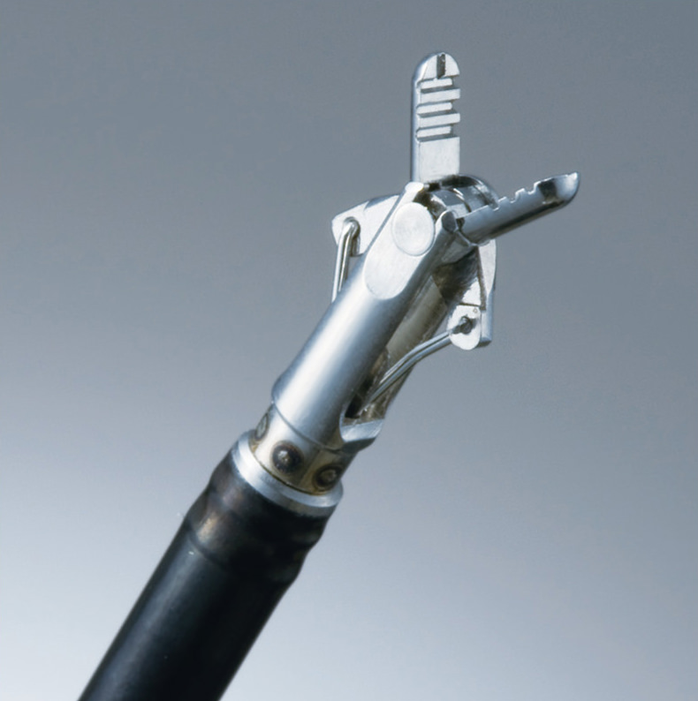
Electrocautery and Bleeding Interventions
Electrocautery:
Uterus not in between direction of current from catheter to grounding pad
Preferably bipolar electrocautery
Regular sphincterotomy is safe
Postpone elective polypectomy
Injection therapy bleeding site:
Adrenalin class C drug; safe
Histoacryl-lipiodol class C drug; safe?
Combine with bipolar therapy

Slide 31

Back to our Case
27 year old female
24 wk gestational age
EUS under deep sedation
Confirmation of cholecholithiasis
ERCP with sphincterotomy and stone extraction
No post ERCP pancreatitis
Uncomplicated a term delivery

Slide 32
Take home messages
Endoscopy is justified when it is clear that failure to perform the procedure could expose the fetus and/or mother to harm
Endoscopy is generally safe during pregnancy
  Have a good indication, semi-elective endoscopy in second trimester
  Consultation from an obstetrician
  Consultation from an anesthesiologist
Periprocedural considerations
  Sedation
  Fetal monitoring
  Positioning of patient, Minimize radiation exposure, Electrocautery

Slide 33

P.J.F. de Jonge, MD PhD
p.dejonge@erasmusmc.nl

