Slide 1

BIG Data in de Zorg…
Introductie | Klinische praktijk | Big Data & Tech | Successen | Overwegingen |
Cefas Dam Business Development Manager Healthcare SAP NL
Product Manager KPN Health per 1/12/’19
Notes:
Omdat inspiratie het thema is neem ik jullie mee in wat mij inspireert en ook hoe ik de mijn reis binnen Zorgautomatisering ervaar. Ik houd van wielrennen, vanwege de vrijheid, omdat het inherent oneerlijk is, wat mij fascineert en omdat het mij helpt. In de bergen maakt het mij nederig en ontstaat een echte “overlevings modus” ik ben geen goede klimmer. Maar de bergen zijn eerlijk. Als je nog 30 km moet (dit is de laatste 8 km van de Stelvio van 30km ongeveer. lijkt zo’n berg onbedwingbaar. Maar als je er aan start en niet nadenkt hoever je nog moet, dan kom je er. DE ZORG, IS NET ZO. Na iedere bocht een nieuwe. Nooit likt het af en toch…. Voor mij staat de zorg gelijk aan IT, hoe kan ik een bijdrage leveren vanuit de automatisering om Medewerkers gelukkiger te maken, Patienten zorg te bieden die werkelijk persoonlijk is en data gedreven. Mijn advies. Start die reis, ga alleen naar de eerste bocht, leer, heb plezier en deel met je collega’s. Het peleton zal groeien en de bochten volgen elkaar sneller en sneller op. Want digitalisering, is voor altijd.

Slide 2
Disclaimer
Introductie | Klinische praktijk | Big Data & Tech | Successen | Overwegingen |
The information in this presentation is confidential and proprietary to SAP and may not be disclosed without the permission of SAP. Except for your obligation to protect confidential information, this presentation is not subject to your license agreement or any other service or subscription agreement with SAP. SAP has no obligation to pursue any course of business outlined in this presentation or any related document, or to develop or release any functionality mentioned therein.
This presentation, or any related document and SAP's strategy and possible future developments, products and or platforms directions and functionality are all subject to change and may be changed by SAP at any time for any reason without notice. The information in this presentation is not a commitment, promise or legal obligation to deliver any material, code or functionality. This presentation is provided without a warranty of any kind, either express or implied, including but not limited to, the implied warranties of merchantability, fitness for a particular purpose, or non-infringement. This presentation is for informational purposes and may not be incorporated into a contract. SAP assumes no responsibility for errors or omissions in this presentation, except if such damages were caused by SAP’s intentional or gross negligence.
All forward-looking statements are subject to various risks and uncertainties that could cause actual results to differ materially from expectations. Readers are cautioned not to place undue reliance on these forward-looking statements, which speak only as of their dates, and they should not be relied upon in making purchasing decisions.

Slide 3


Agenda
Introductie | Klinische praktijk | Big Data & Tech | Successen | Overwegingen |
IT in de klinische praktijk
Technologie als katalysator?
Praktijkvoorbeelden - ASCO: CancerLinQ - Institute Gustav Roussy
Conclusie
Bewustzijnext steps

Slide 4
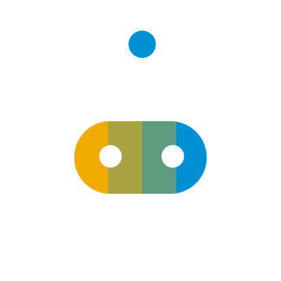



4 Stellingen: Eens (staan) of Oneens (zitten)
Introductie | Klinische praktijk | Big Data & Tech | Successen | Overwegingen |
Digitale technologie is een Hoax en zal het klinisch process niet beinvloeden
Ik geloof dat er betere informatie is dan ik nu kan meewegen in de behandelkeuze.
Ik heb meer impact op patientzorg met een algoritme dan een behandeling
Mijn besluiten zijn gebaseerd op uitkomsten uit de klinische praktijk.
Notes:
Big data in de zorg, laten we eens bepalen waar we staan.

Slide 5

Introductie | Klinische praktijk | Big Data & Tech | Successen | Overwegingen |
Uitdagingen met (Big) Data in de zorg?
NL meest gedigitaliseerd zorgstelsel - Gebrek aan uitwisseling tussen systemen.
- Richten ons op vastlegging, onvoldoende op het benutten van data,
Gepersonaliseerd- v.s. protocol - Hoe bepaal je de juiste behandelmethode?
- Zijn risicofactoren goed in schatten?
- Kan ik een gepersonaliseerde behandeling kiezen?
Notes:
This is what it feels like.
To do a machine learning study in the medical space
Derive a plan / Study
Go 2 Medical Ethical Committee
Identify the dataset you require
Connect to the various hospitals and colleagues
Create a legal framework (most difficult)
Create a technical environment
Find the data > Cleanse it > Unify it > and with each step reduce the footprint whilst bringing the outcome at risk
Do the study TO FINALLY BRING VALUE

Slide 6


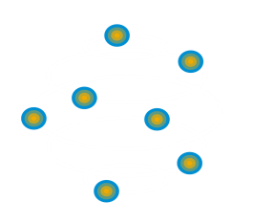

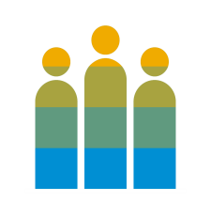
Klinische praktijk: Strategische prioriteiten zorgbestuur
Introductie | Klinische praktijk | Big Data & Tech | Successen | Overwegingen |
Operationeel Efficiënt
Betere uitkomsten voor patiënten
Data-gedreven Klinische Innovaties
Patient/Klant beleving
Bekrachtigd personeel
Wegnemen van onnodige kosten, vrijmaken van capaciteit voor innovatie en betere patientzorg / dienstverlening.
Verschuiven van volume naar waarde. Gericht op het verbeteren van uitkomsten voor individuele patienten.
Hoe komen we van een reactief, op ervaring gestoeld model tot een gepersonaliseerd medisch advies op basis van real-world evidence?
Hoe kunnen we voldoen aan de verwachting van patienten die zich gedragen als zorg consumenten.
Hoe kunnen zetten we onze medewerkers in hun kracht en faciliteren wij hen om de beste zorg te leveren?
Disruptie!?
Notes:
Wat zijn de belangrijkste thema’s die wij bij vrijwel alle zorgbestuurders terug zien komen. Fundamenteler begint de vraag te worden. Welke rol moeten wij als instelling nu gaan spelen, terwijl het zorglandschap wijzigt.
References:
1. No Author. Digital health comes of age. Self-disrupt or self-destruct. Accenture Consulting. [Internet] (2014, cited on 2018, June 20). Available at: https://www.accenture.com/t20171219T083448Z__w__/us-en/_acnmedia/PDF-57/Accenture-Health-Digital-Health-Comes-Of-Age.pdf

Slide 7
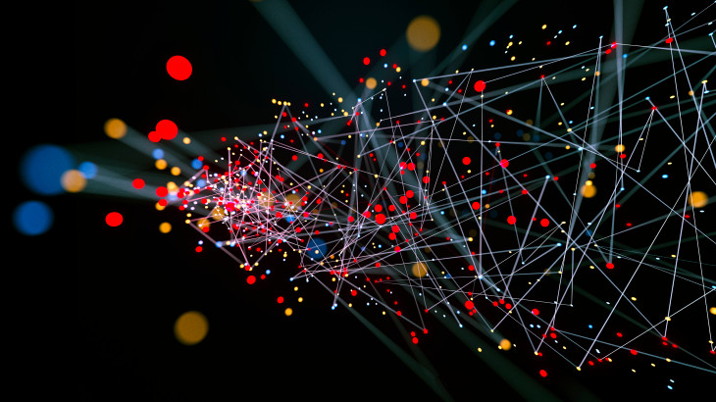



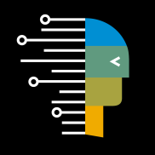



Big Data
Introductie | Klinische praktijk | Big Data & Tech | Successen | Overwegingen |
Gartner “Big data is high-volume, high-velocity and/or high-variety information assets that demand cost-effective, innovative forms of information processing that enable enhanced insight, decision making, and process automation”
Blockchain
Internet of Things (IoT)
Sensors
Machine learning and AI
APIs
Conversational UIs
Mobile
Notes:
What does digital transformation imply and how can businesses succeed? ​
New forms of systems of intelligence are emerging with embedding AI, ML, Big Data, Analytics, IoT and blockchain.​
These new data driven systems of Intelligence enable us to reap unprecedented value from data, unlock new business models and re-imagine business process – across supply chains, customer interactions, work force experiences and many more.​
​​
Digital Transformation Tool Chest:​
According to world bank, there were more than 7.2 bio mobile subscriptions in 2015; 325,000 mobile health apps available in 2017, robust growth of 25% year-on-year (https://research2guidance.com/325000-mobile-health-apps-available-in-2017/)​
Medical Sensors Market worth 15.01 Billion USD by 2022 (marketsandmarkets report) – ingestibles, implantables etc. ​
IoT – estimate 50 billion connected devices by 2020 (in logistics) – predictive maintenance use cases, also at home diagnostics & healthcare e.g. startups like Cue, healthy.io​
Machine learning & AI in the cloud: By 2018, 75% of enterprise and ISV development will include AI or ML. – IDC​
Use cases: quick evolution to detect and identify anomalies, automate processes, and provide prescriptive problem resolution​
Blockchain – securing supply chain to optimize processes, increase transparency and trust among stakeholders​
APIs - By 2019, APIs , will be the primary mechanism to connect data, algorithms, and decision services. – IDC​
Conversational UIs: By 2019, natural-language generation will be a standard feature of 90% of modern BI platforms. – Gartner​
​

Slide 8
Big Data & digitale technologie als katalysator
Introductie | Klinische praktijk | Big Data & Tech | Successen | Overwegingen |
Combineren van verschillende digitale bronnen Vraagt een bewerkingen om tot waarde te komen.
Blockchain
Internet of Things (IoT)
Sensoren
Machine learning and AI
APIs
Visualisatie
Mobiel
Notes:
What does digital transformation imply and how can businesses succeed? ​
New forms of systems of intelligence are emerging with embedding AI, ML, Big Data, Analytics, IoT and blockchain.​
These new data driven systems of Intelligence enable us to reap unprecedented value from data, unlock new business models and re-imagine business process – across supply chains, customer interactions, work force experiences and many more.​
​​
Digital Transformation Tool Chest:​
According to world bank, there were more than 7.2 bio mobile subscriptions in 2015; 325,000 mobile health apps available in 2017, robust growth of 25% year-on-year (https://research2guidance.com/325000-mobile-health-apps-available-in-2017/)​
Medical Sensors Market worth 15.01 Billion USD by 2022 (marketsandmarkets report) – ingestibles, implantables etc. ​
IoT – estimate 50 billion connected devices by 2020 (in logistics) – predictive maintenance use cases, also at home diagnostics & healthcare e.g. startups like Cue, healthy.io​
Machine learning & AI in the cloud: By 2018, 75% of enterprise and ISV development will include AI or ML. – IDC​
Use cases: quick evolution to detect and identify anomalies, automate processes, and provide prescriptive problem resolution​
Blockchain – securing supply chain to optimize processes, increase transparency and trust among stakeholders​
APIs - By 2019, APIs , will be the primary mechanism to connect data, algorithms, and decision services. – IDC​
Conversational UIs: By 2019, natural-language generation will be a standard feature of 90% of modern BI platforms. – Gartner​
​

Slide 9

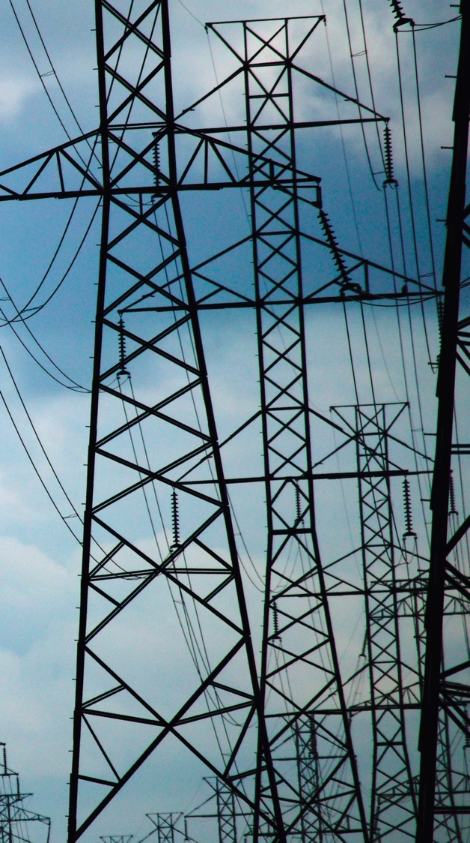
Introductie | Klinische praktijk | Big Data & Tech | Successen | Overwegingen |
“Thinking, Fast and Slow” – Digitale methoden leveren een bijdrage, maar…
In de lente:
Groen groot object = Boom
Grijs groot object = mast
Notes:
In medical practice physicians must use their judgment, intuition and rely on guidelines that are more related to superficial characteristics (like origin of tumor) than precise molecular understanding of the underlying molecular drivers.
Taking these constraints and the limited time a physician has, it is necessary to apply heuristics that seem to work in some cases. A physician simply has no chance today to think statistically and derive outcome probabilities given the symptoms and the available treatment options. Daniel Kahneman has analysed the cognitive mechanisms behind our everyday decision making and demonstrated that thinking heuristically, as developed through the evolution can be powerful and fast way of making decisions, but it also leads to strong biases, especially in complex situations such as economic decision making. The same is true in medicine.
Simplistic rules derived from a low number of observation and features can be applied fast, but they lead to mistakes.

Slide 10

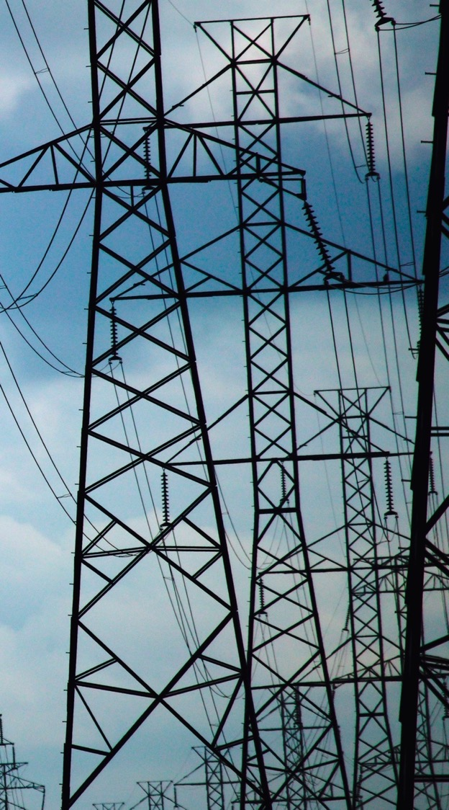
Introductie | Klinische praktijk | Big Data & Tech | Successen | Overwegingen |
… maar in de winter faalt het algoritme
Grijs groot object = boom = mast

Slide 11

Introductie | Klinische praktijk | Big Data & Tech | Successen | Overwegingen |
Waarde gedreven door Data?
Digitalisering leidt tot data lakes.
Machine learning kan tot onverwachtte inzichten leiden!
Waarom heeft de Big Data doorbraak in de Zorg nog niet plaats gevonden?
Notes:
Probably some of you know very well that already in the 80’s 90’s multiple powerful machine learning algorithms were available. Still at this time, machine learning was a niche and the discussion was rather dominated by artificial intelligence, which applied more heuristics than data driven learning.
Without data one has to meet important assumptions and models. Speaking more informally, one is forced to use strong heuristics to explain observations and predict outcomes.
Today, when tons of data is available multiple industries found innovative ways to leverage the enormous value in these datasets. Models are directly derived from the data without a priori assumptions that would constrain the solution space or generate bias. Working data driven opens to door to generate insights about hidden interdidependencies, for example discover early indicators for sepsis, that one would have never thought of before.

Slide 12
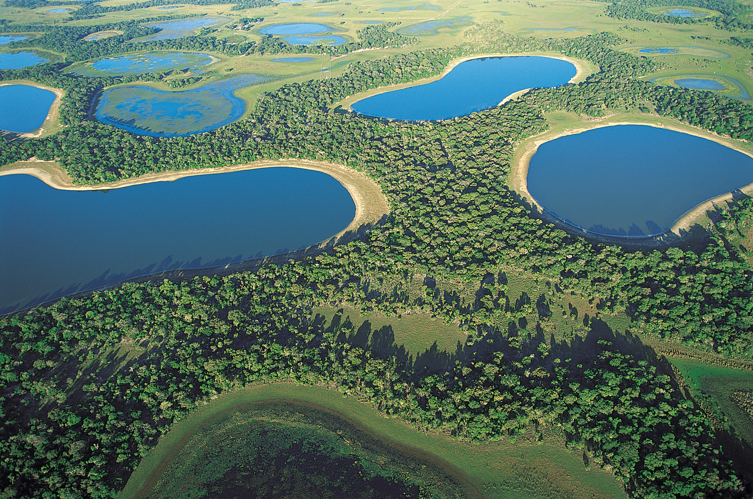
Introductie | Klinische praktijk | Big Data & Tech | Successen | Overwegingen |
Data is Gefragmenteerd
We beschikken alleen over te kleine datasets. – complexe systemen kunnen we daarom niet modelleren.
Notes:
Probably some of you know very well that already in the 80’s 90’s multiple powerful machine learning algorithms were available. Still at this time, machine learning was a niche and the discussion was rather dominated by artificial intelligence, which applied more heuristics than data driven learning.
Without data one has to meet important assumptions and models. Speaking more informally, one is forced to use strong heuristics to explain observations and predict outcomes.
Today, when tons of data is available multiple industries found innovative ways to leverage the enormous value in these datasets. Models are directly derived from the data without a priori assumptions that would constrain the solution space or generate bias. Working data driven opens to door to generate insights about hidden interdidependencies, for example discover early indicators for sepsis, that one would have never thought of before.

Slide 13



Succesvolle BIG Data Initiatieven
Introductie | Klinische praktijk | Big Data & Tech | Successen | Overwegingen |
ASCO CancerLinQ (USA)
Beslisondersteuning voor 35.000 oncologen
1.5 Mio genormaliseerde patientendossiers
Real-time bevragen & cohort bouwen
14 verschillende EPD’s
Implementatie 1e Kliniek, 18mnd, nu 3 weken
Institut Gustav Roussy (Parijs)
300.000 dossiers via Tekst-mining Snomed gecodeerd.
Genetische data in Real-time verwerkt.
Gepersonaliseerde behandelkeuze o.b.v. genetisch profiel
Notes:
What does digital transformation imply and how can businesses succeed? ​
New forms of systems of intelligence are emerging with embedding AI, ML, Big Data, Analytics, IoT and blockchain.​
These new data driven systems of Intelligence enable us to reap unprecedented value from data, unlock new business models and re-imagine business process – across supply chains, customer interactions, work force experiences and many more.​
​​
Digital Transformation Tool Chest:​
According to world bank, there were more than 7.2 bio mobile subscriptions in 2015; 325,000 mobile health apps available in 2017, robust growth of 25% year-on-year (https://research2guidance.com/325000-mobile-health-apps-available-in-2017/)​
Medical Sensors Market worth 15.01 Billion USD by 2022 (marketsandmarkets report) – ingestibles, implantables etc. ​
IoT – estimate 50 billion connected devices by 2020 (in logistics) – predictive maintenance use cases, also at home diagnostics & healthcare e.g. startups like Cue, healthy.io​
Machine learning & AI in the cloud: By 2018, 75% of enterprise and ISV development will include AI or ML. – IDC​
Use cases: quick evolution to detect and identify anomalies, automate processes, and provide prescriptive problem resolution​
Blockchain – securing supply chain to optimize processes, increase transparency and trust among stakeholders​
APIs - By 2019, APIs , will be the primary mechanism to connect data, algorithms, and decision services. – IDC​
Conversational UIs: By 2019, natural-language generation will be a standard feature of 90% of modern BI platforms. – Gartner​
​

Slide 14
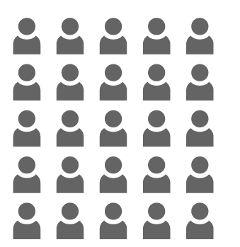
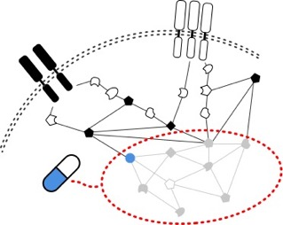

Introductie | Klinische praktijk | Big Data & Tech | Successen | Overwegingen |
Lastig om alle biologische werking/ complexiteit te overzien
1 medicijn doel vs. diverse profielen
Resulteert in
Werkzaamheid vs. ”gouden standaard” behandelingen
beperkte data punten & ontbreken van moleculair profiel
Ontbrekend inzicht op mechanisme van werking
20-40% werkzaamheid geneesmiddel
Medicatie is vaak ineffectief voor complexe ziektebeelden.
Behandeling Non-effectieve werkzaamheid
Kanker: 75%
Alzheimer: 70%
Arthritis: 50%
Diabetes: 43%
Depressie: 43%
Notes:
Personalized medicine is today more an aspiration than reality.
Clinical trials are run on a very small and carefully selected cohort of patients. Such a limited data set is enabling only very limited insights in the root nature and diversity of biological mechanisms and diseases.
No wonder that due to missing data, drug efficacy for all common complex diseases is limited to around 20 to 40% with no understanding when, why and for whom a drug works and when not.
It is probably painful to admit, but in several cases, we cannot do more than to apply really smart, but heuristic rules: e.g. we look at the origin of the tumor, we check pathology, etc.
Source:
http://www.fda.gov/downloads/ScienceResearch/SpecialTopics/PersonalizedMedicine/UCM372421.pdf
Spear, B.B., Heath-Chiozzi, M., & Huff, J. (2001). Clinical application of pharmacogenetics. TRENDS in Molecular Medicine, 7(5), 201-204

Slide 15
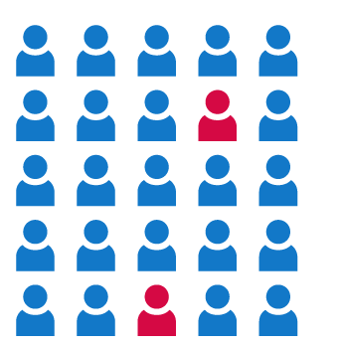
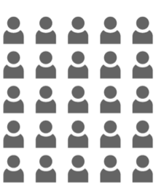
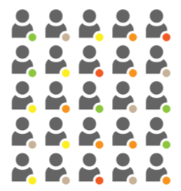


Introductie | Klinische praktijk | Big Data & Tech | Successen | Overwegingen |
Delen van informatie
Gepersonaliseerde advertenties
Het netwerk effect
Social Media is een motor voor data generatie. Op basis van profielen data-gedreven “geindividualiseerde advertenties“
Positive feedback loop (vrienden mijn activiteiten)
Notes:
Let´s look at some big players from like facebook and instagram, who have managed to motivate stakeholders to record and more importantly share their data.
The enormous amount of collected data can be instantly turned into mind blowing insights about economic trends, consumer preferences and individual profiles. Recently just from the changing pattern of geospatial information of consumers entering into a Chipotle it was possible to predict a significant drop in a companies revenues. This insight had material consequences on the companies market value and share price well before its quarterly reports. (see details below)
How could we generate similar valuable insights in healthcare? For example understand the reason certain clinics using different treatment guidelines as others. Understanding complex patters of patients with different co-morbidities reacting to certain treatments and selecting the statistically most promising ones. Predict the emergence of certain disease and recommend prevention as early as possible?
Chipotle announced its first loss as a public company Tuesday. But two weeks earlier, an unlikely source —the social media app Foursquare — had beat Chipotle to the punch, predicting in a blog post that the burrito maker’s sales would drop nearly 30 percent. Chipotle made it official Tuesday afternoon — reporting a drop of 29.7 percent.
The remarkably accurate prediction from a company consumers know for restaurant tips and the ability to check in at locations highlights the emerging power of the gobs of data our smartphones collect and the opportunity for savvy companies to convert that information into piles of cash.
“In biology the microscope changed the world. In physics and astronomy, the telescope,” said University of Illinois at Urbana-Champaign professor Lav Varshney. “These data sets give a very detailed view of human behavior. It’s a really powerful instrument in all kinds of settings.”
Foursquare has spent seven years collecting data and has 85 million places in its database. It describes its data trove as the “biggest foot traffic panel in the world.” Clients that buy Foursquare’s data to glean insights include retailers, real estate developers, Wall Street traders and consumer package-goods companies.
Foursquare, the seven-year-old start-up, cleverly turned smartphone data into predictions on Chipotle sales that matched Wall Street analysts with far more experience in projecting the successes of businesses such as Chipotle. Last year, Foursquare used its foot-traffic data to predict how many iPhones Apple would sell on a given weekend. Foursquare predicted sales of 13 million to 15 million. Apple then announced sales of more than 13 million.
https://www.washingtonpost.com/news/innovations/wp/2016/04/28/how-foursquare-knew-before-almost-anyone-how-bad-things-were-for-chipotle/

Slide 16
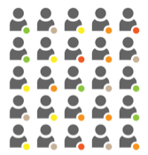
Introductie | Klinische praktijk | Big Data & Tech | Successen | Overwegingen |
Delen van informatie
Precision health
Sluit de kennis cirkel feedback naar de klinische praktijk.
Behandeling A:
78% inefficacy
Behandeling B:
60% inefficacy & adverse events
“Patiënten als de mijne” Vergelijken van individuele patiënten met grote populaties.
Mijn patient
Patienten als de mijne
Behandeling C:
40% inefficacy
Statistisch inzicht
Notes:
Imagine if a physician could instantly query in a large database for patients that show similar symptoms, sets of diagnosis, vital parameters, etc as hers to figure out how they have reacted to multiple treatment options.
Gaining insights from real world evidence would allow her to select the best possible treatment.
And even better: now seeing the value of entering high quality data in electronic systems she would be highly motivated to share her observations and follow up information on her patients.
By allowing such data sharing mechanisms digital health systems grow beyond serving billing and other transactional purposes. In the eyes of physicians at the point of care data entry is a unpleasant necessity and and information ”cemetery”. If his information was queryable over multiple dimensions and long time follow ups the value would become immediately apparent.
Such feedback loop can and will create virtuous circles of data sharing and knowledge generation.

Slide 17
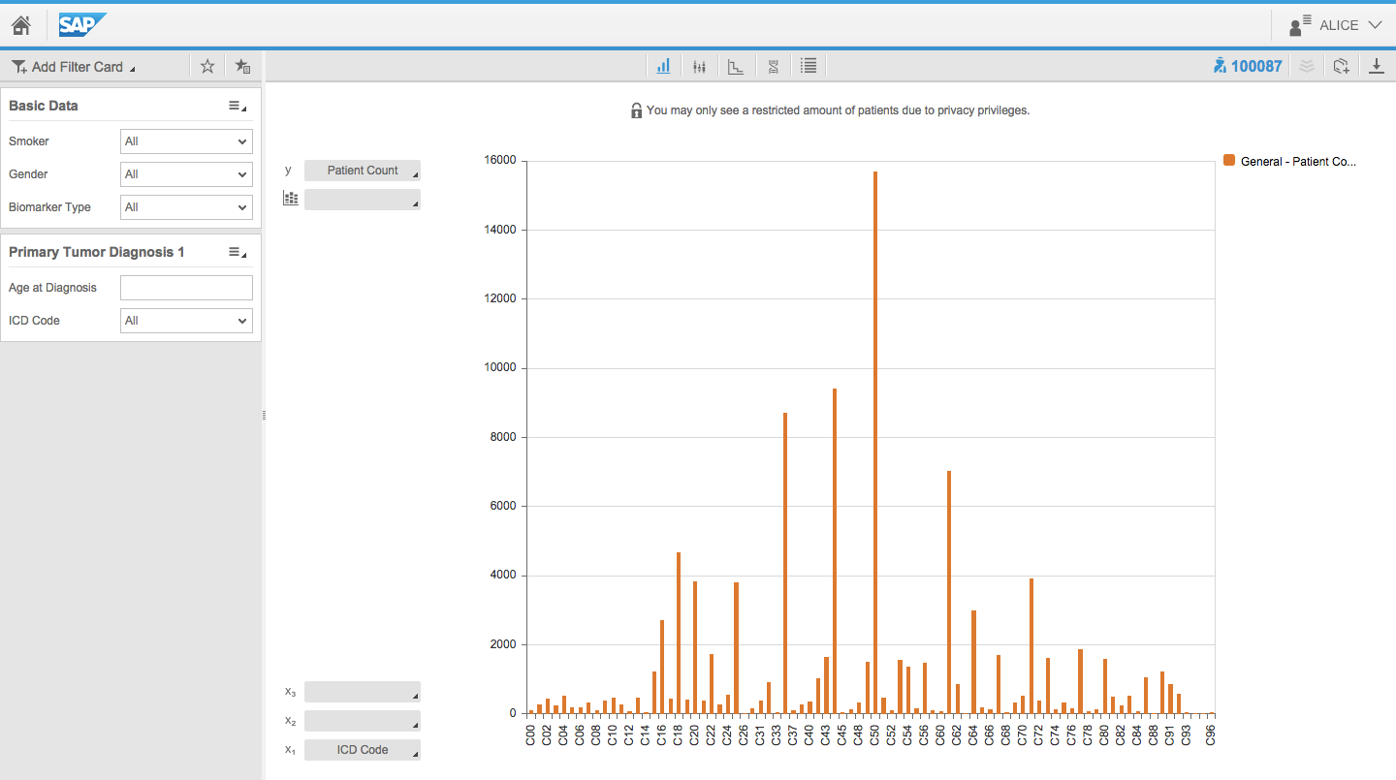
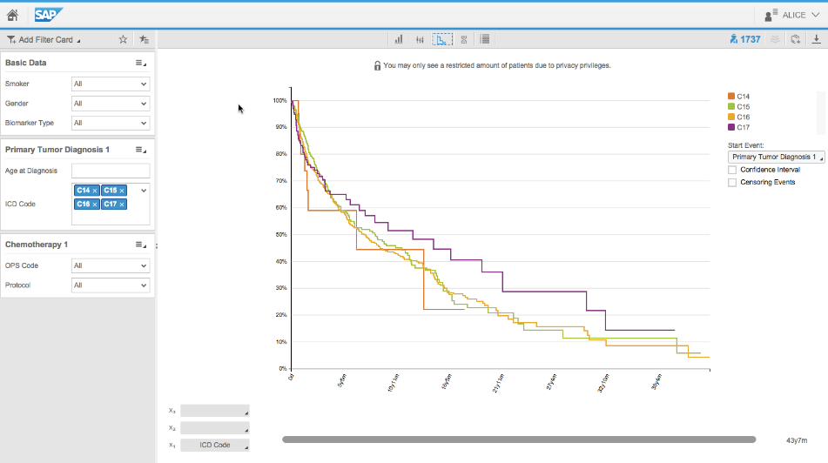
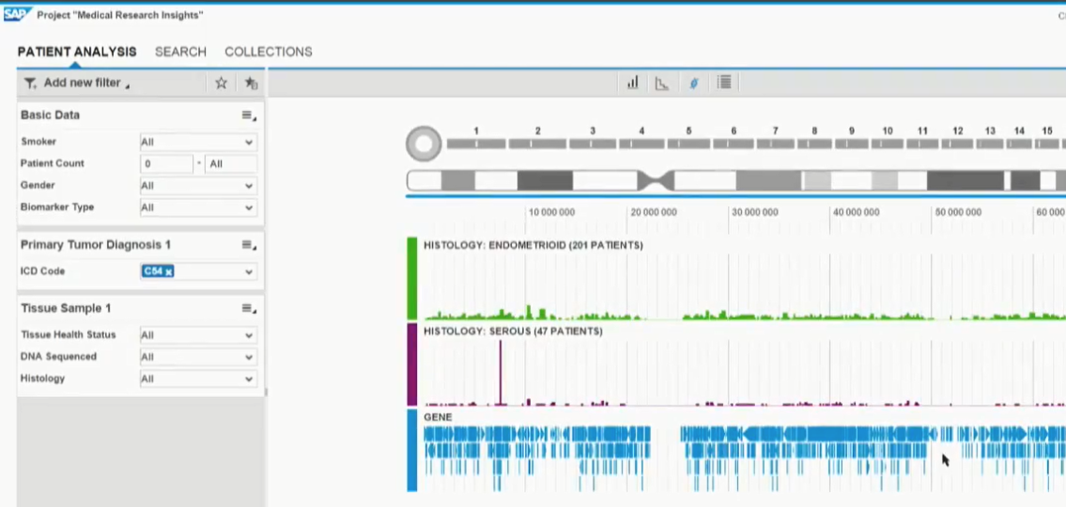
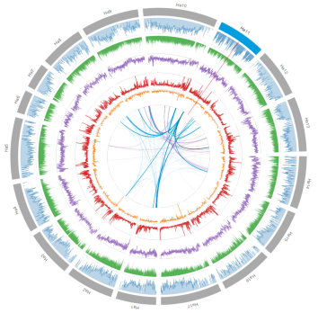
Introductie | Klinische praktijk | Big Data & Tech | Successen | Overwegingen |
Statistische kracht: Patienten als de mijne
Realtime dataverwerking
Patient Analyse & Cohorts
Patient Timeline
Genetische data / Identificeren van bio markers
ASCO/CancerLinQ live met meer dan 1.5 mio patienten
IGR
Notes:
SAP’s product Medical Research Insights runs on the Connected Health Platform
This tool supports rich analytic capabilities to explore patient data that are integrated in the Connected Health Platform. This tool support translational medical research as well as can be use at the point of care.
Some example application opportunities are
Compile patient cohorts for further exploration
Obtain patient distributions
Explore survival probabilities for different treatments for a specific patient group (this is highly useful if no evidence or treatment guidelines are available for patients with particular comorbities)
Identify genetic markers – correlate genetic properties with patient outcomes, histology, etc

Slide 18




Data gedreven gezondheidszorg
Intro | ZIB & beleid | Data platform | SAP Health | Machine Learning | Plenair
Functies
Diagnostiek
Interactie met patiënten
Behandelkeuze
Vroeg signalering & preventie
Functies,
Pseudonimisering
Analyse datasets
Publicaties
Algoritmes
Functies
Beleid / protocol
Vergoeden & controleren
Stelsel wijzigingen
Behandelaar
Onderzoeker
Beleid / betaler
Functies
?
Patient
Notes:
Waar gaan we heen? Wat is die zorg van morgen? Alle persona’s in de zorg hebben een afhankelijkheid. Maar het stelsel richt zich niet op de gehele keten. Toelichting bij deze afhankelijkheden. * Zorg wordt pas beter als deze keten wordt gesloten, maar hoe? * Hoe wordt de zorg van morgen: Evidence based, data driven, Outcomes, Value based Healthcare? De perspectieven moeten gelijk worden. We hebben allemaal, dezelfde data nodig. ZORG WORDT ALLEEN BETAALBAAR ALS ZORGDATA WORDT ALS HET WARE EEN NUTSVOORZIENING. HOE MAKEN WE DIT MOGELIJK, WAT DOET SAP?

Slide 19
Doel: Data gedreven gezondheidszorg
Introductie | Klinische praktijk | Big Data & Tech | Successen | Overwegingen |
Functies
Vergoeden & controleren
Beleid
Stelsel wijzigingen
Beleid / betaler
Functies
Data verzamelen zonder verstoring
Contact met zorgverleners
Community
Consent
Real-time data Samenwerken - Inzicht - Aanpassen
Functies
Diagnostiek
Interactie met patiënten
Behandelkeuze
Vroeg signalering & preventie
Behandelaar
Patient
Functies, Pseudonimisering
Analyse datasets
Publicaties
Algoritmes
Onderzoeker
Notes:
Waar gaan we heen? Wat is die zorg van morgen? Alle persona’s in de zorg hebben een afhankelijkheid. Maar het stelsel richt zich niet op de gehele keten. Toelichting bij deze afhankelijkheden. * Zorg wordt pas beter als deze keten wordt gesloten, maar hoe? * Hoe wordt de zorg van morgen: Evidence based, data driven, Outcomes, Value based Healthcare? De perspectieven moeten gelijk worden. We hebben allemaal, dezelfde data nodig. ZORG WORDT ALLEEN BETAALBAAR ALS ZORGDATA WORDT ALS HET WARE EEN NUTSVOORZIENING. HOE MAKEN WE DIT MOGELIJK, WAT DOET SAP?

Slide 20
Overwegingen
Introductie | Klinische praktijk | Big Data & Tech | Successen | Overwegingen |
Digitalisering zal ook de zorgsector ingrijpend beïnvloeden
Patiënt zorg & informatie uitwisseling gaan hand in hand. De patiënt of hij/zij participeert met data.
(Zorg) Data is een waarde houdend goed, de bekostiging zal volgen.
De kwaliteit, toegankelijkheid en inzetbaarheid van jullie dataset is bepalend voor de markt relevantie van het instituut.
Artsen zullen de informatievoorziening (algoritmes) ontwikkelen, duiden en toetsen.
Bits & Bytes leveren geen patiëntzorg ☺

Slide 21
Vragen & Reacties
Introductie | Klinische praktijk | Big Data & Tech | Successen | Overwegingen |
Cefas Dam Business Development Manager Healthcare Netherlands email: cefas.dam@gmail.com
Mob: +31 (0) 6 15253560

